Slide 1
Cryogenic Quantum Diamond Microscope
4K Magneto-optic microscope with I-V characterization
Quantum Cryogenic Lab
IIT Bombay
Lab Phone Number : +91 22 2576 9413

Slide 2
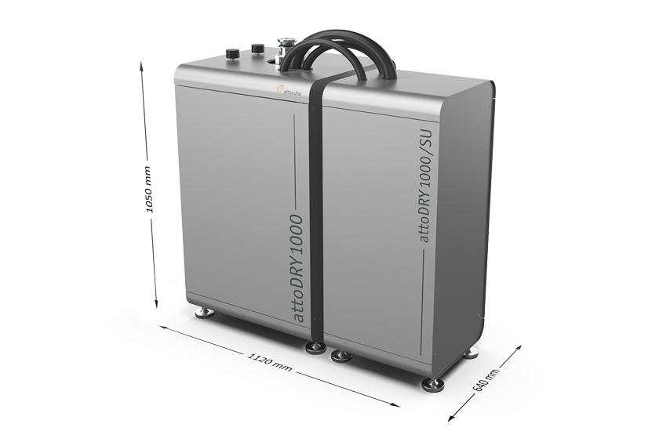
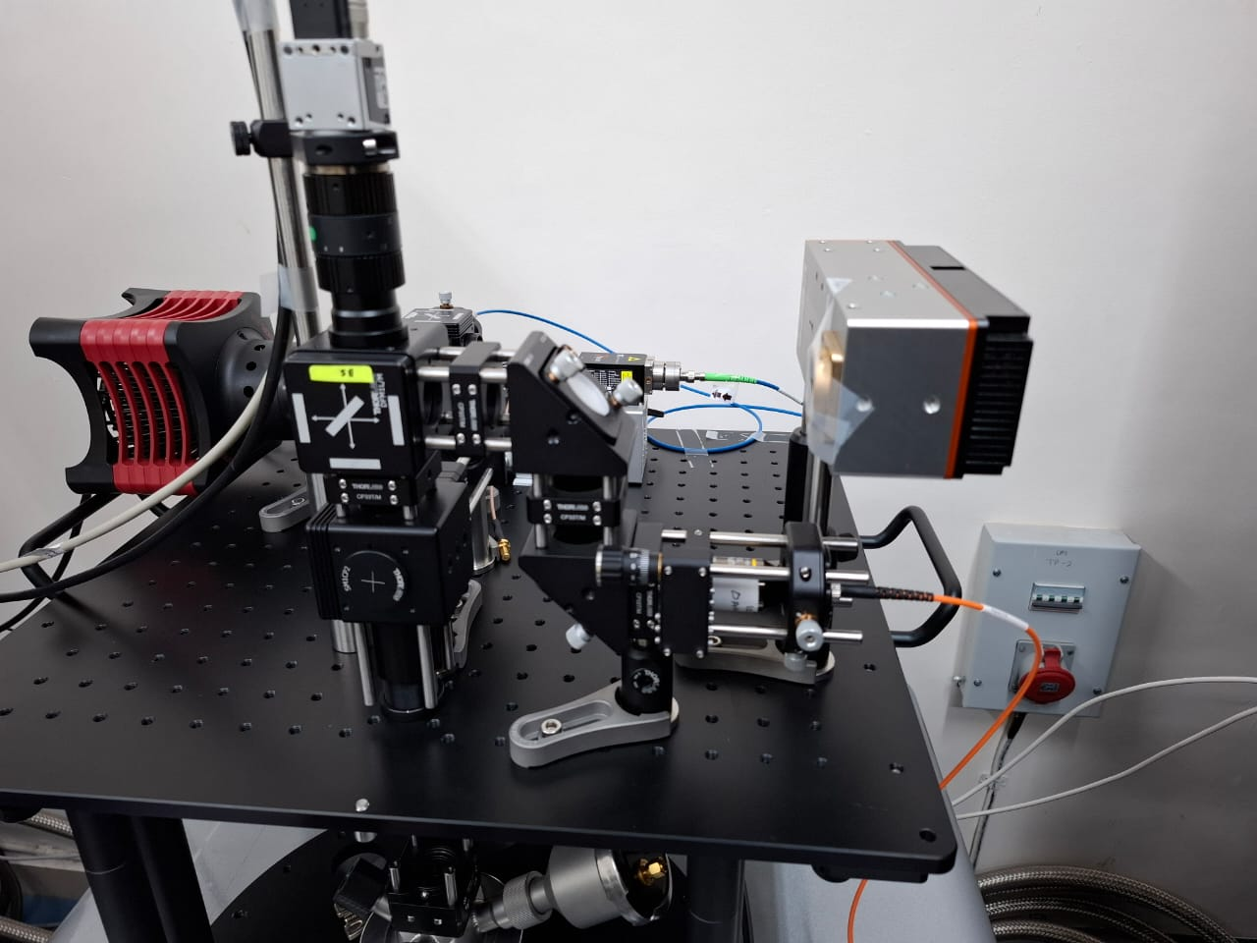
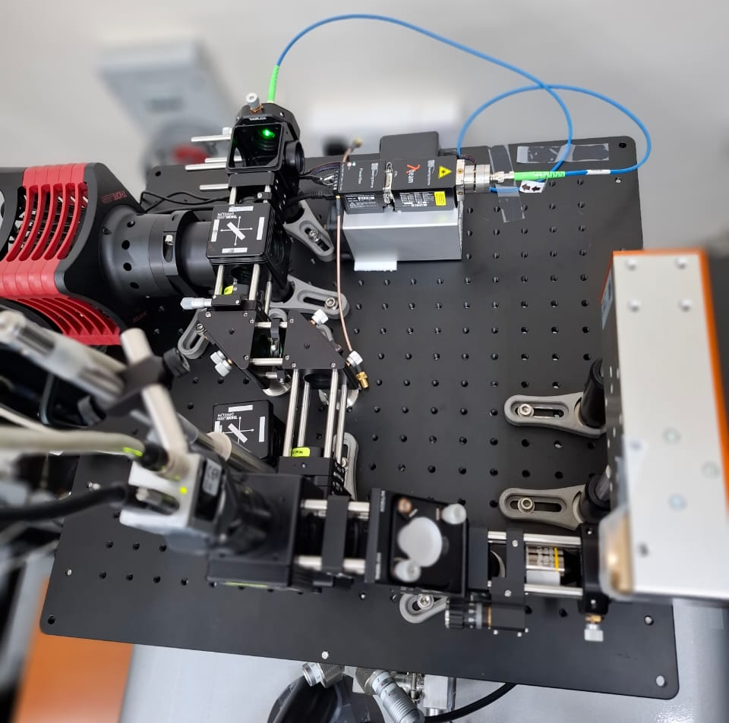
attoDRY 1000 cryostat
Top loading closed cycle cryostat with Superconducting magnet
Cryogen-free & low vibration cryostat platform, no liquid helium required
Cryostat
Microscope [Left: Front view, Right: Top view]

Slide 3
cQDM Specifications
Cryostat model : attoDRY 1000
Base temperature : 3.5 K
Sample temperature : 4 K (variable up to 70 K & above)
Superconducting vector magnets : upto ±1 Tesla in X, Y, Z
Excitation laser : 532 nm (0 - 70 mW)
Brightfield & magnetic field imaging possible
Microwave measurement : 12.4 MHz - 6 GHz
Spectrometer : Andor Kymera 328i
Per pixel sensitivity : 1 - 5 µT/√Hz
I-V measurements are also possible
PL measurements are also possible from 4 K to 70 K
Notes:
For above 70 K measurement, Helium is required & process can be long to get particular vacuum in respective chambers, so the slot charges may vary. (Isolation chamber, OVC, IVC)
Excitation with 635 nm laser with limited power is possible.
Currently setup is operating in widefield mode but confocal mode also possible along with spectroscopy.

Slide 4
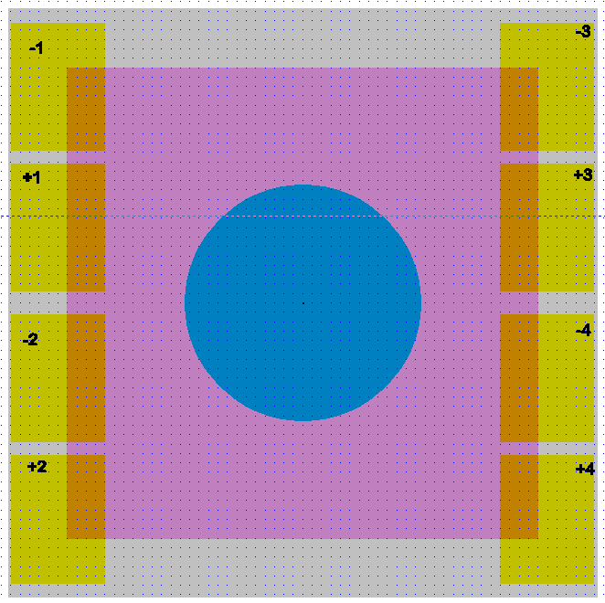
Substrate Design : With Diamond
Sample size : 6 mm*6 mm
Diamond : 4 mm*4 mm
Microwave antenna region : 2 mm diameter
Contact pads : maximum 8 (with markers)
Gray : Total substrate/sample size (6*6)mm
Pink : Diamond (4*4)mm
Blue : Microwave region (2 mm diameter)
Yellow : Contact pads (Minimum 70 um diameter/square)
-/+1, -/+2, -/+3, -/+4 : contact pads markers (follow the sequence)
2 mm diameter
4 mm
6mm
4 mm
6 mm
Notes:
Maximum 28 devices with 2 probes are possible to measure if all are fitting with respective sample area.
But make maximum 4 devices only for 2 probe measurement & 2 devices for 4 probe measurement.

Slide 5
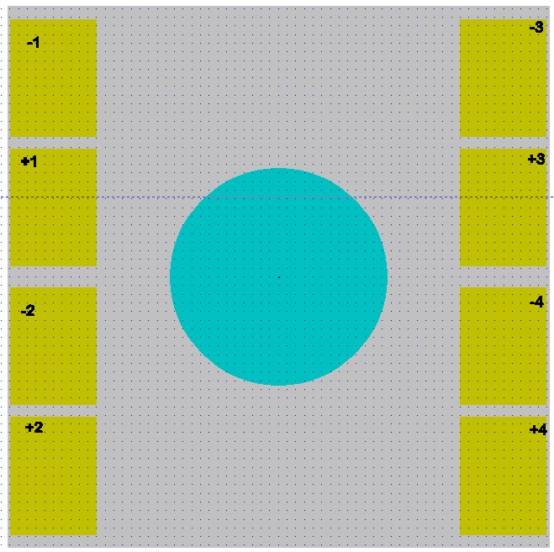
Substrate Design : Without Diamond
Sample size : 6 mm*6 mm
Microwave antenna region : 2 mm diameter
Contact pads : maximum 8 (with markers)
Gray : Total substrate/sample size (6*6)mm
Blue : Microwave region (2 mm diameter)
Yellow : Contact pads (Minimum 70 um diameter/square)

Slide 6
Sample preparation guidelines
Try to make the device/sample at the center of the substrate.
Maximum substrate size allowed is 6 mm *6 mm.
Contact pads should be near the edges of the sample in proper marker & dimensions.
For microwave measurements, make the sample inside the 2 mm diameter circle at the center of the substrate.
For electrical measurement, a maximum of 8 contact pads are possible on the substrate with a minimum dimension of a 70 um circle/square.

Slide 7
Equipment associated with the setup
Photodetector : DET36A2
Basler camera : acA720-520um
Helicam (lock-in) camera
Tektronix AFG (25 MHz) : AFG1022
Mini circuit microwave switch : ZFSWA-63DR+
Temperature controller : Lakeshore 335
Pulse Blaster : Spincore

Slide 8
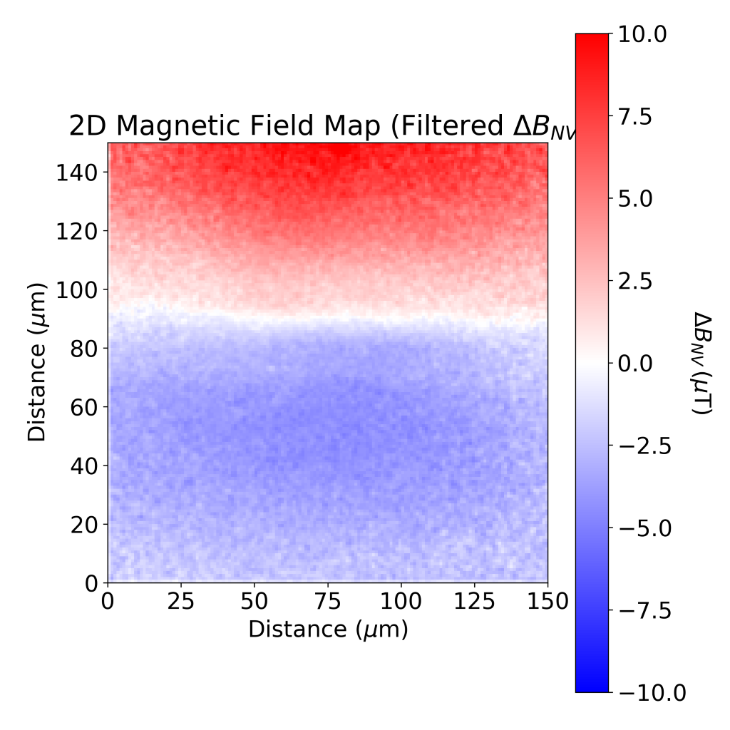
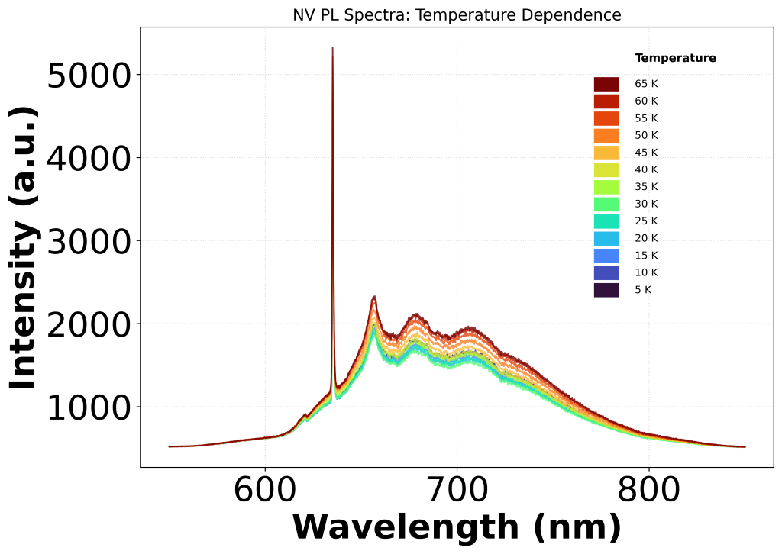
Example measurement with cQDM
Magnetic field image of the wire at 4K
Zero phonon line (ZPL) of the NV spectra [4K - 65K]

