Slide 1
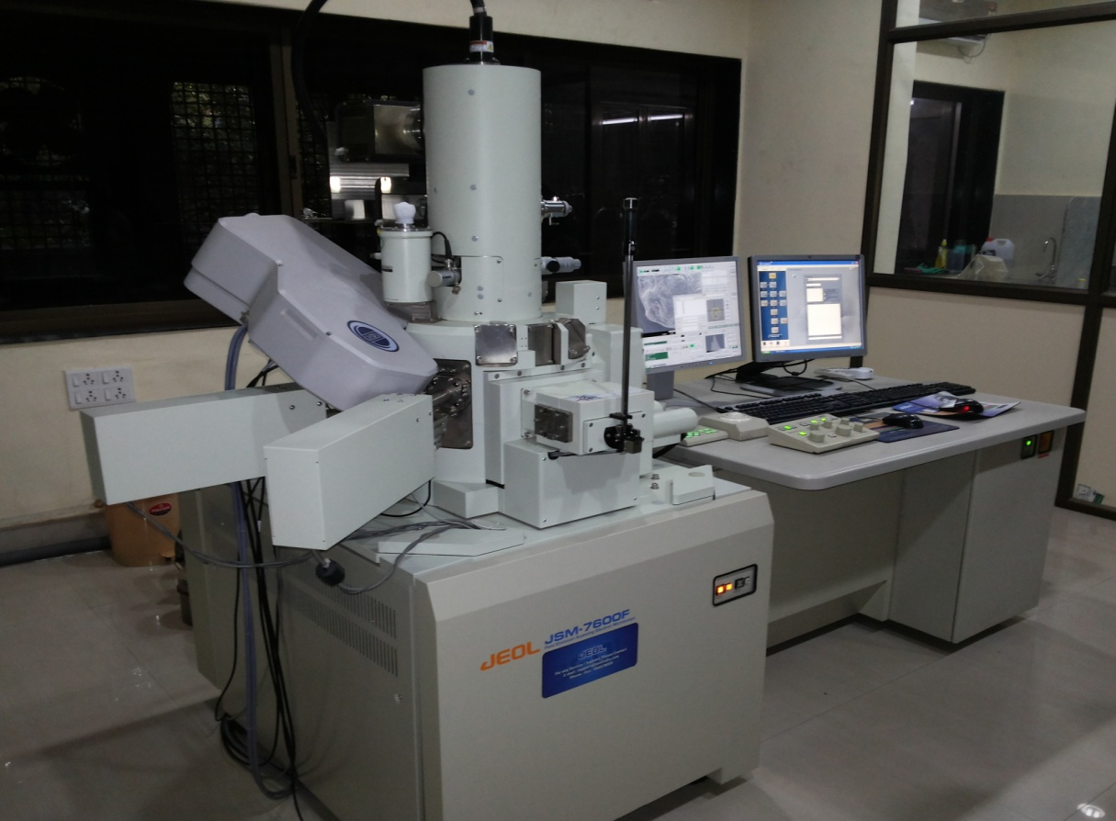
FIELD EMISSION GUN SCANNING ELECTRON MICROSCOPE

Slide 2
TECHNICAL SPECIFICATIONS
Make & Model: JEOL JSM-7600 F
Source: Field emission gun
SEI Resolution: 1.0nm at 15 kv 1.5nm at 1 kv, in GB mode
Magnification: Low: 25X to 10,000X High: 100X to 1,000,000X at 4x5 photo size
Accelerating Voltage: 0.1 to 30 kv
Probe Current Range: 1 pA to ≥ 200 nA
Modes : LM, SEM, GB, EDS- Area,line,mapping
Detectors : SEI, LEI

Slide 3
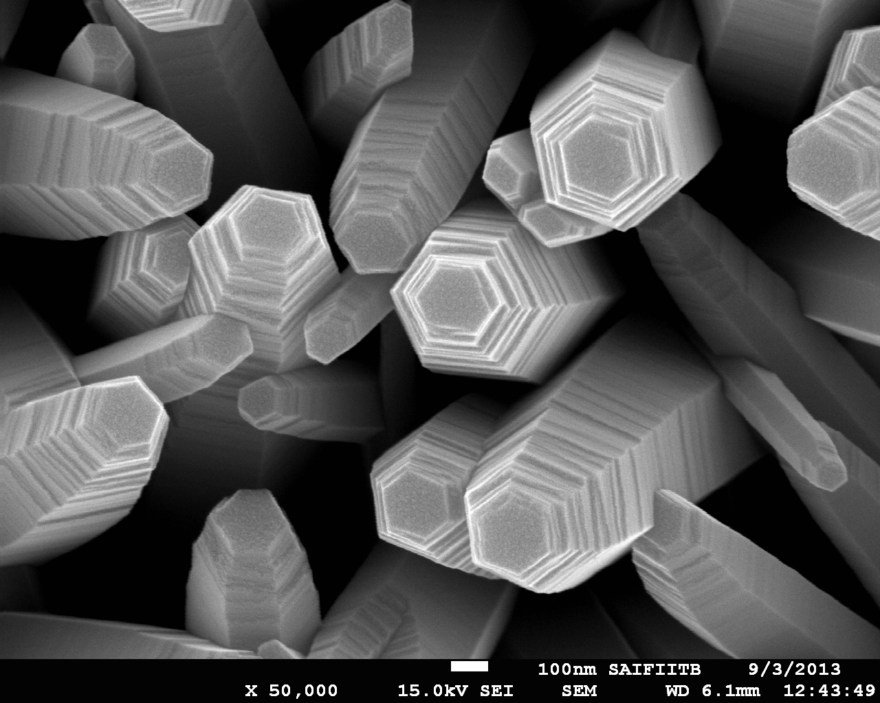
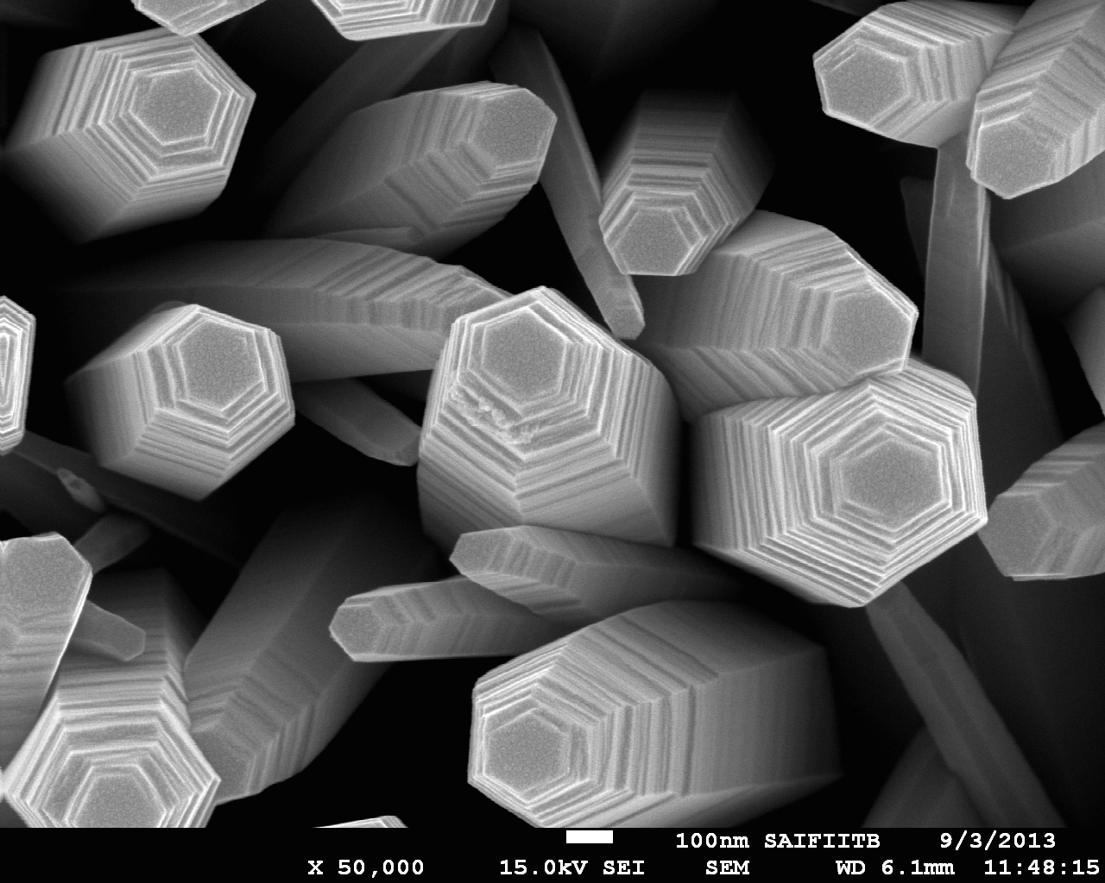
ZnO Nano rods

Slide 4
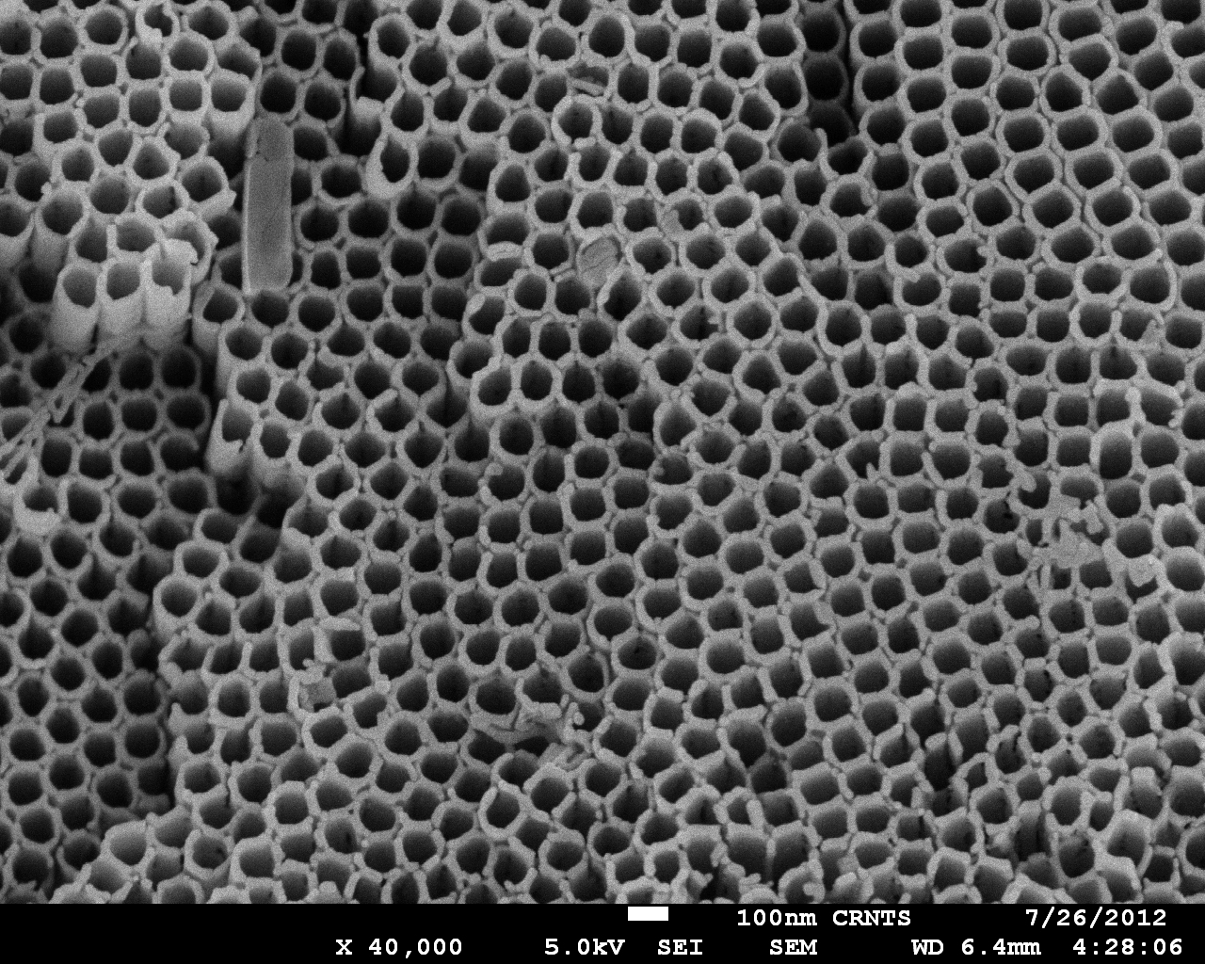
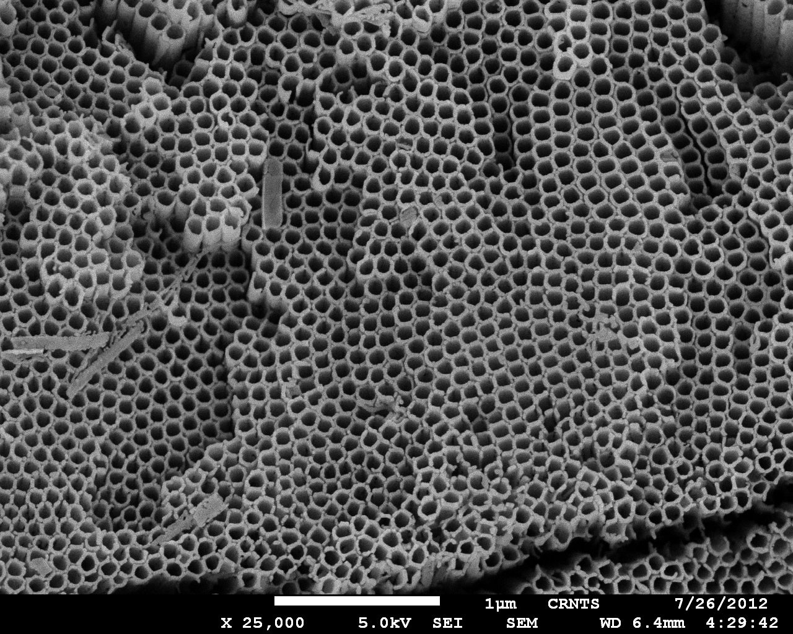
TiO2 Nano rods

Slide 5
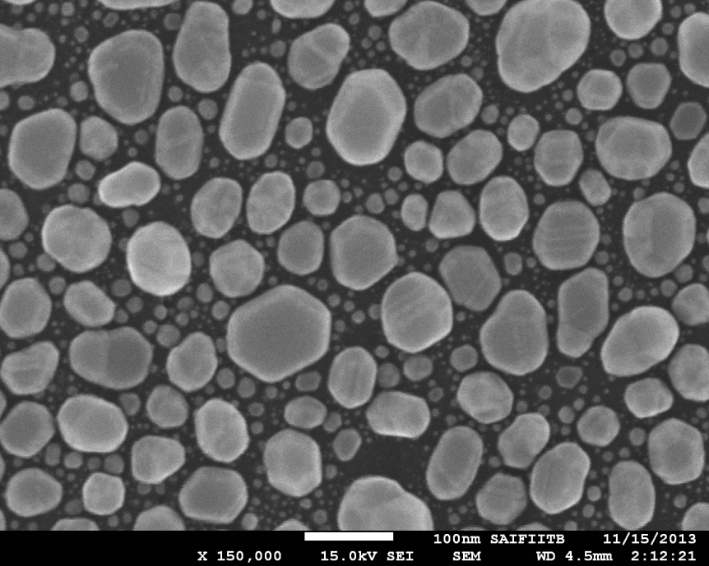
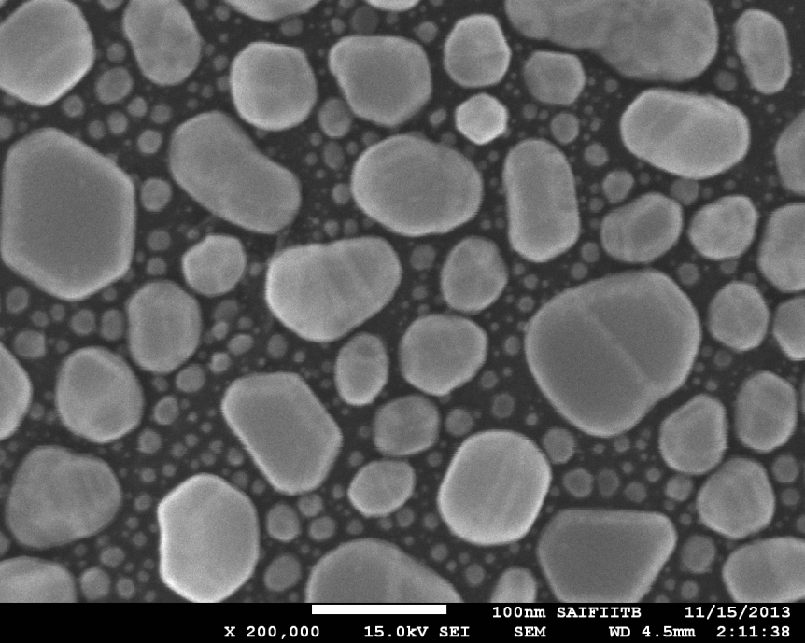
Au Nanoparticles

Slide 6
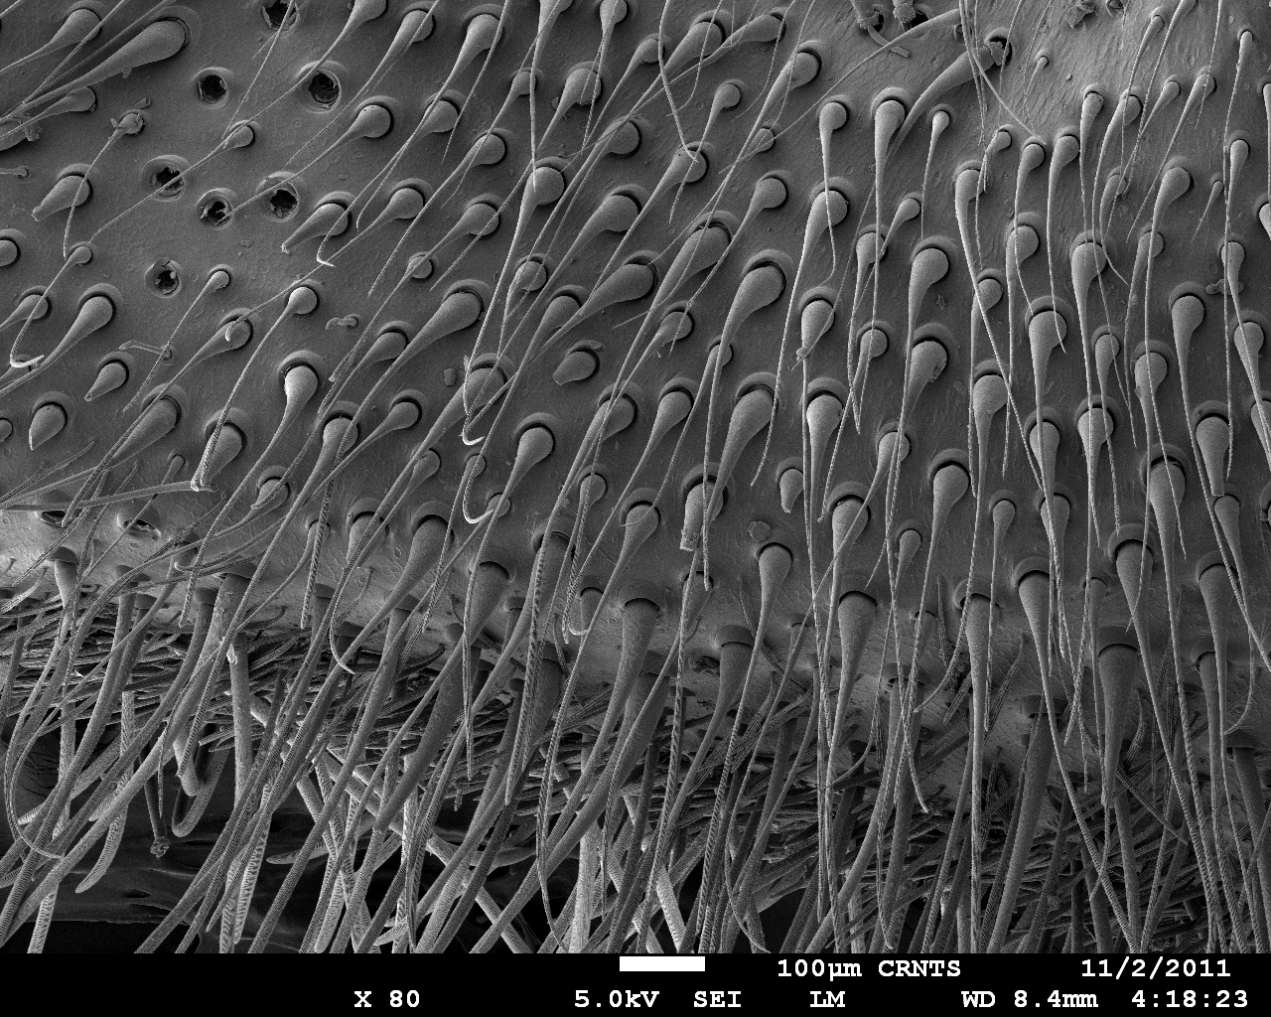
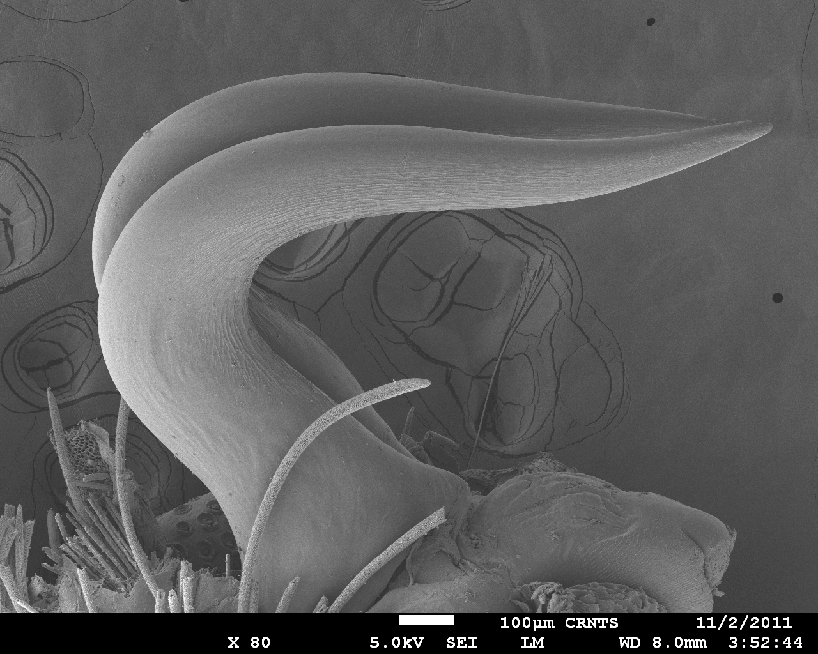
Parts of Spider

Slide 7
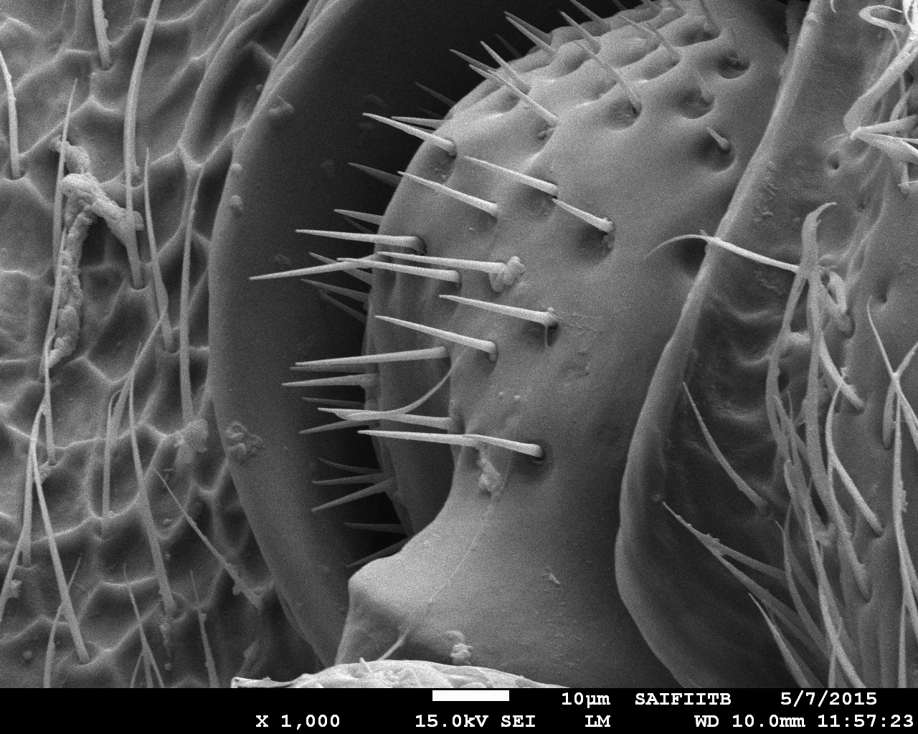
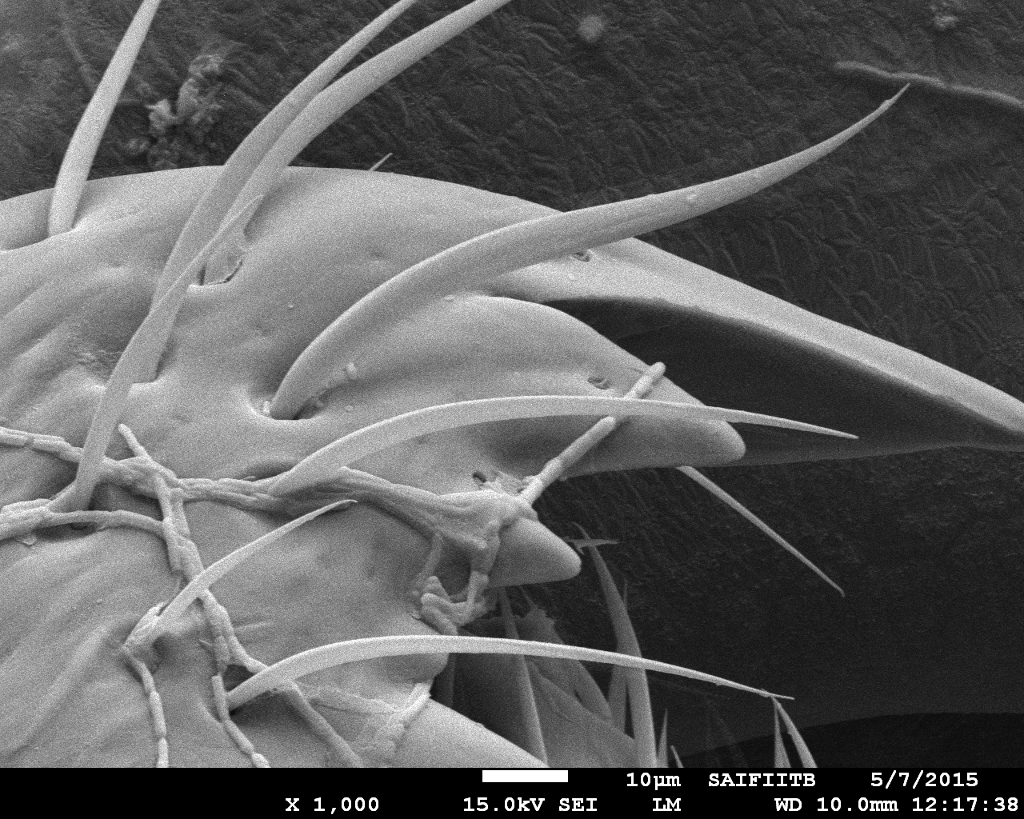
Parts of Ant body

Slide 8
Bacteria

Slide 9
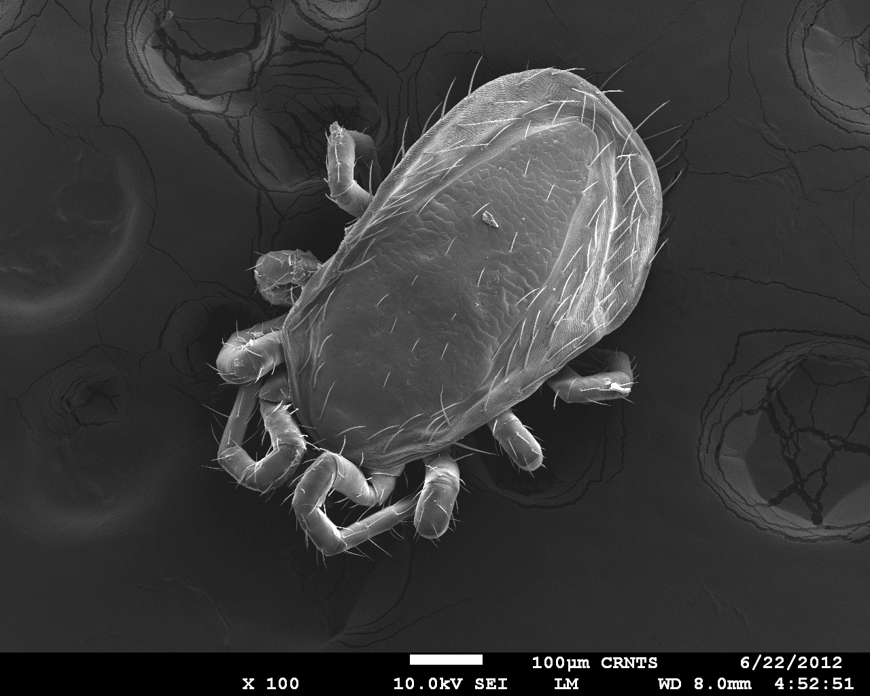
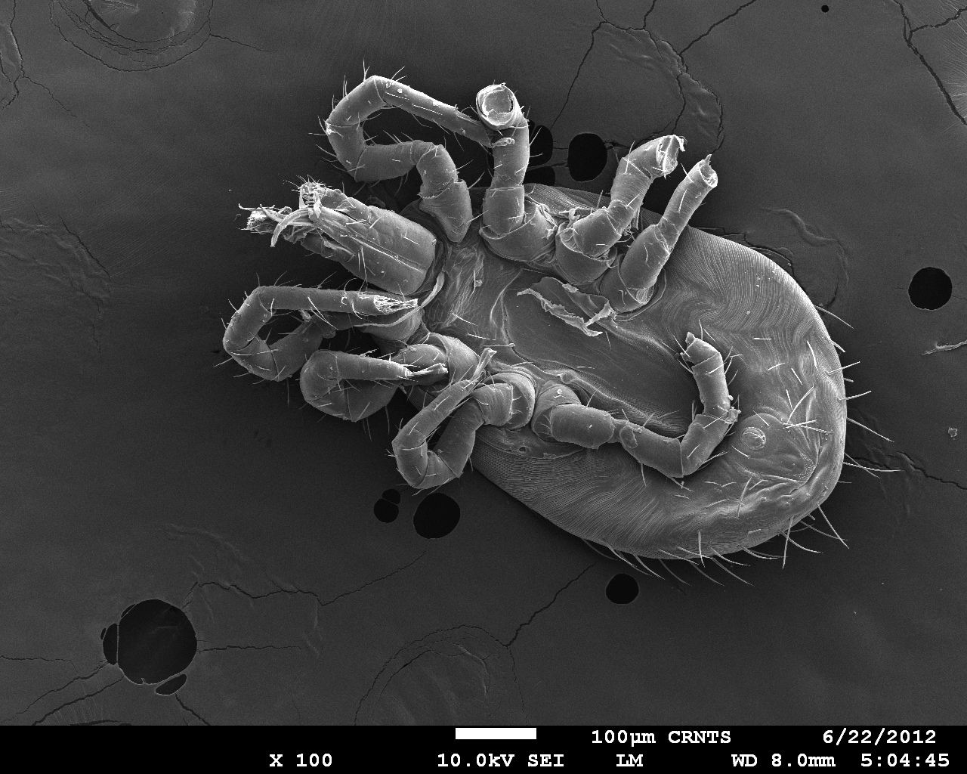
Insect

Slide 10
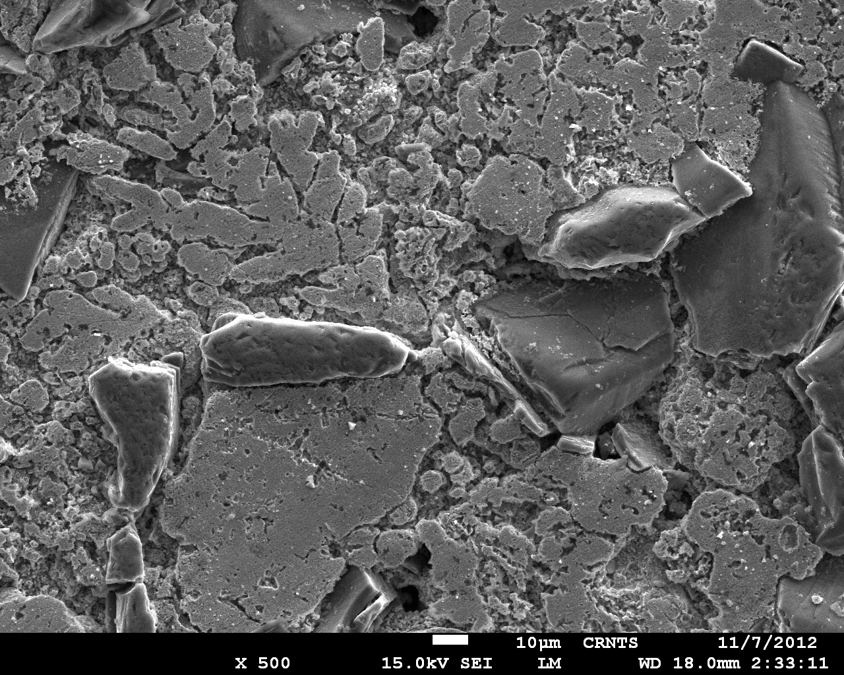
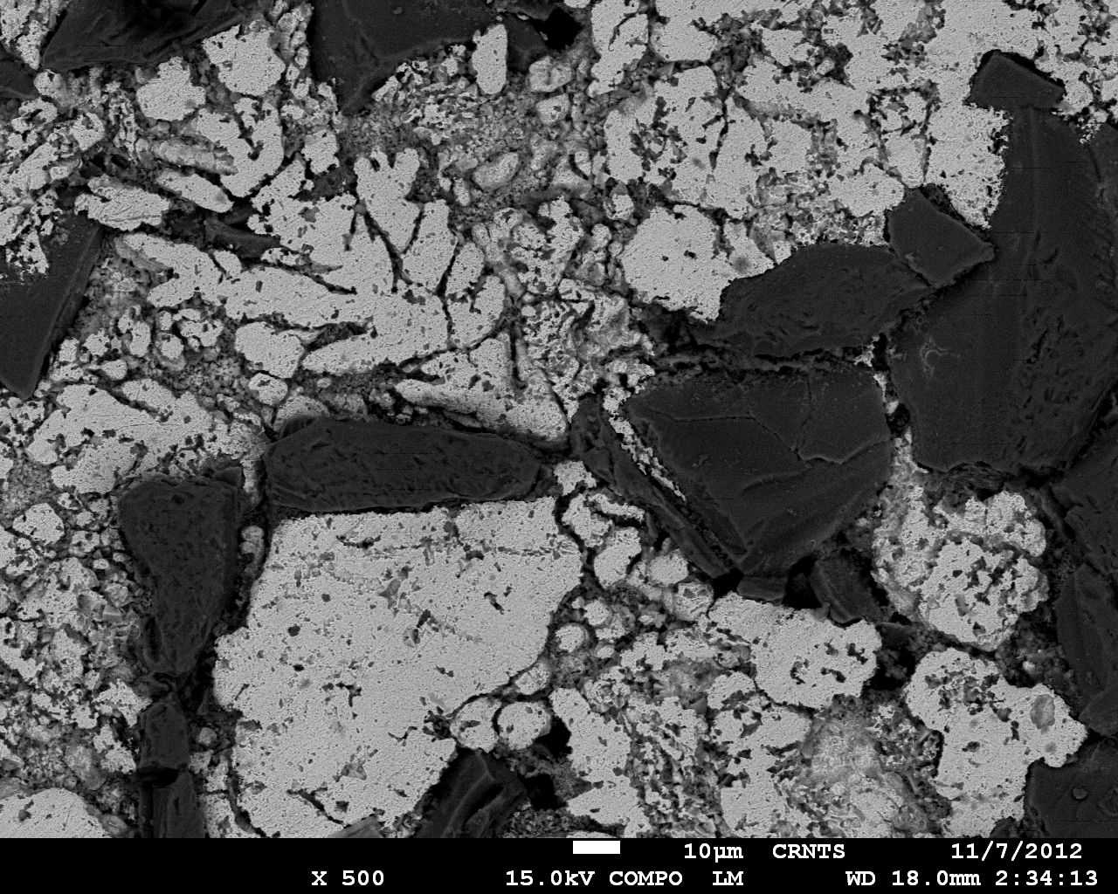
Secondary Imaging Vs BackScattered Imaging

Slide 11
BackScattered Imaging

Slide 12
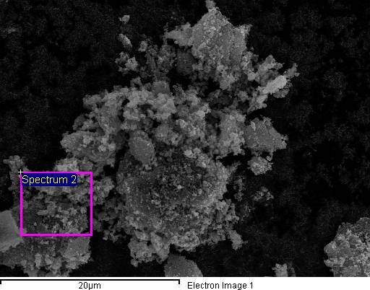
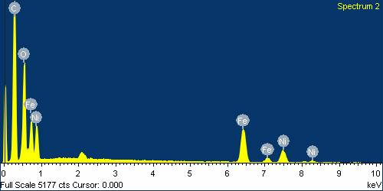
Energy dispersive spectroscopy (EDS)
Element | Weight% | Atomic%
C K | 42.35 | 62.82
O K | 23.90 | 26.61
Fe K | 20.52 | 6.55
Ni K | 13.23 | 4.02
Totals | 100.00

Slide 13
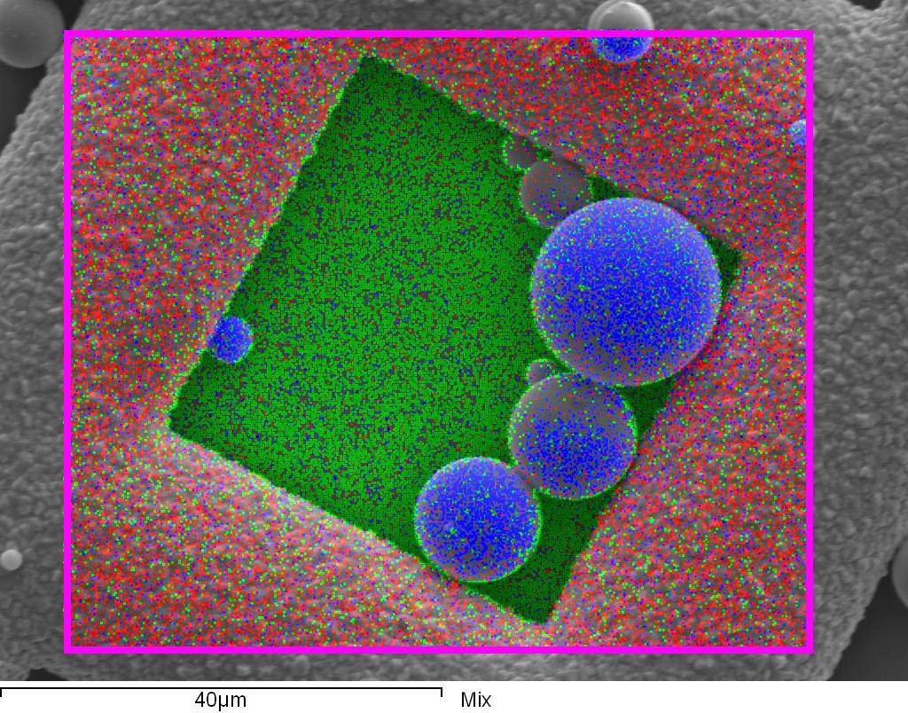
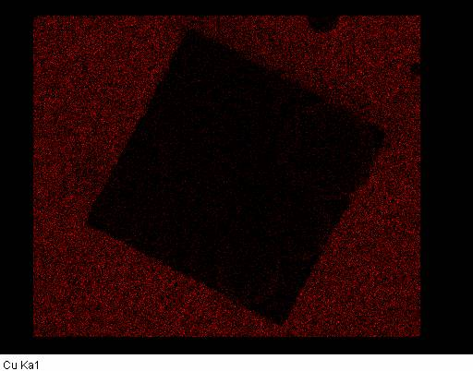
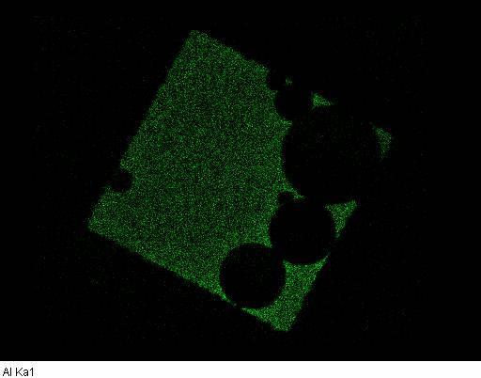
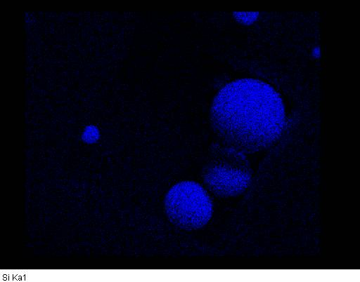
EDS MAPPING

Slide 14
Thank You

