Slide 1
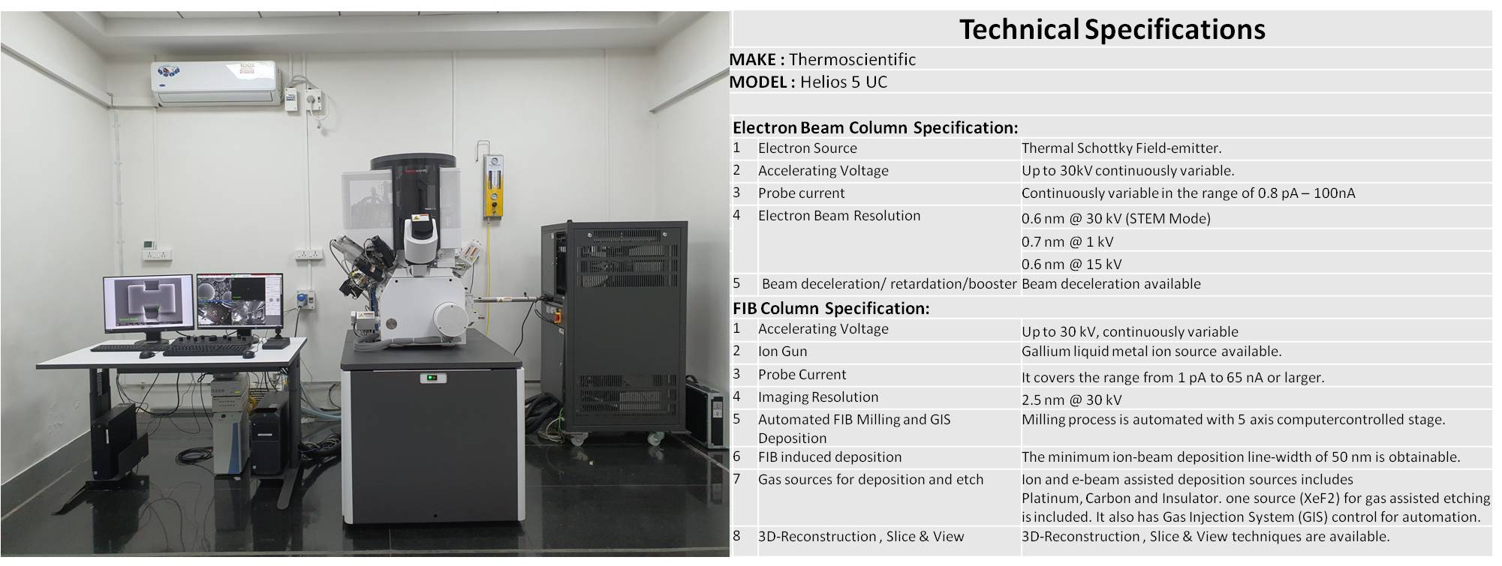
DUAL BEAM – FOCUSED ELECTRON AND ION BEAM

Slide 4
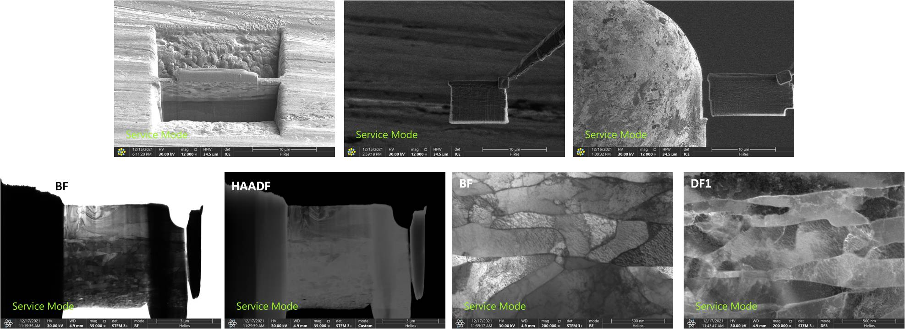
Sample : Interstitial steel
Required information : To study grains and grain boundaries in the sample
Lamella Preparation, Thinning and STEM imaging using FIB at SAIF

Slide 5
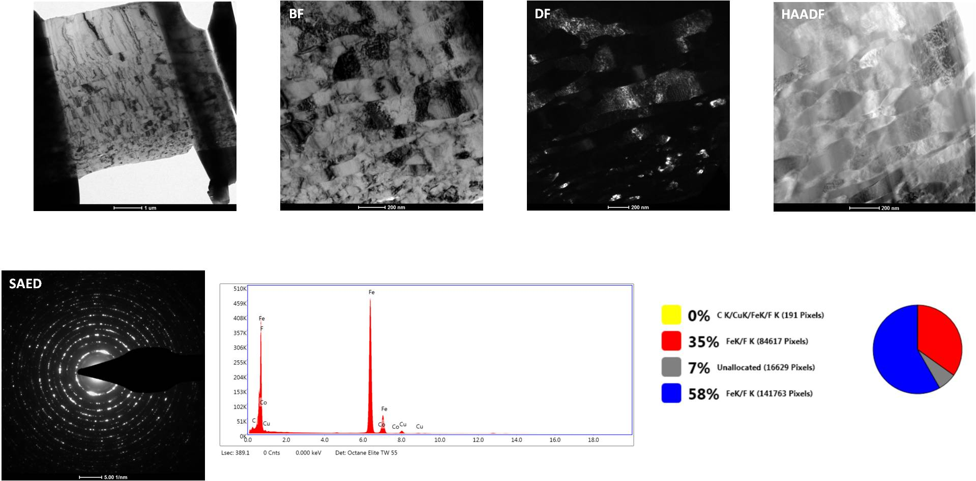
Lamella analysis using TEM Imaging and EDS Characterization (HR-TEM 300 kV, Tecnai G2, F30 at SAIF)

Slide 6
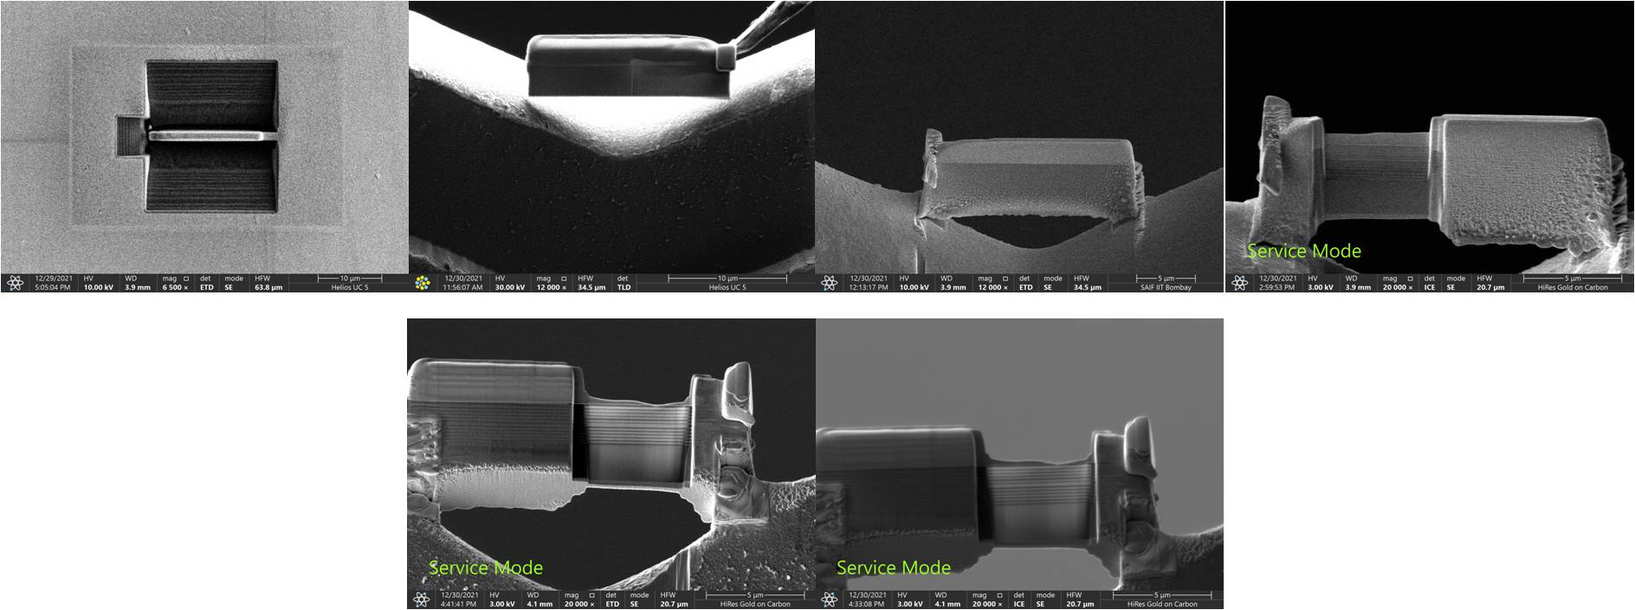
Sample : TiO₂/SiO₂
Required information : To study alternate multilayers of TiO2 and SiO2
Lamella Preparation, Thinning and STEM imaging and EDS analysis using FIB at SAIF

Slide 7
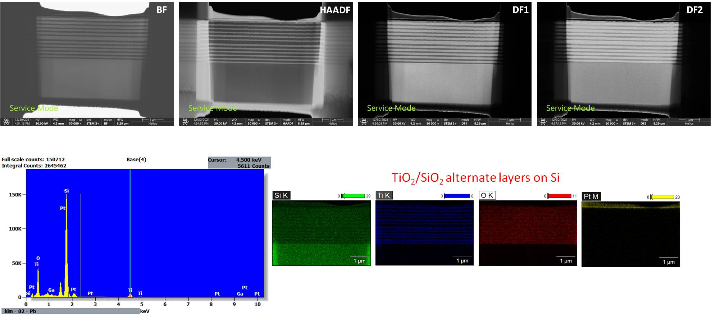
STEM imaging and EDS analysis using FIB at SAIF

Slide 8
Sample 3 : Ni on Pyramidal Si
Required information : To check if oxide is present at the Ni - Si interface
Lamella Preparation, Thinning and STEM imaging and EDS analysis using FIB at SAIF

Slide 9
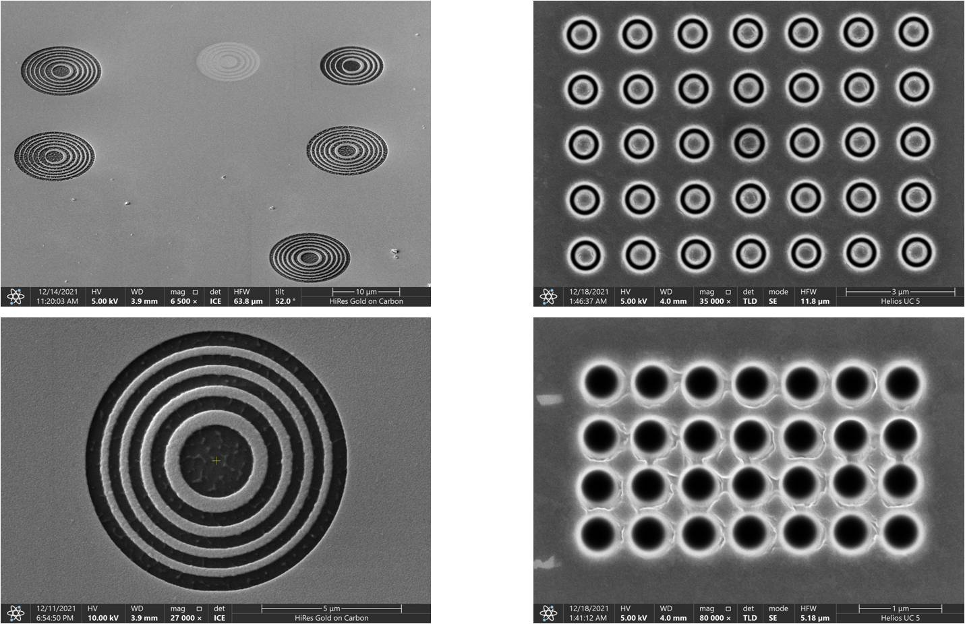
NANO PATTERNING for Optical lenses on gold and Titanium
Nano Patterning on Au using FIB
Micro rings and holes on Titanium

Slide 10
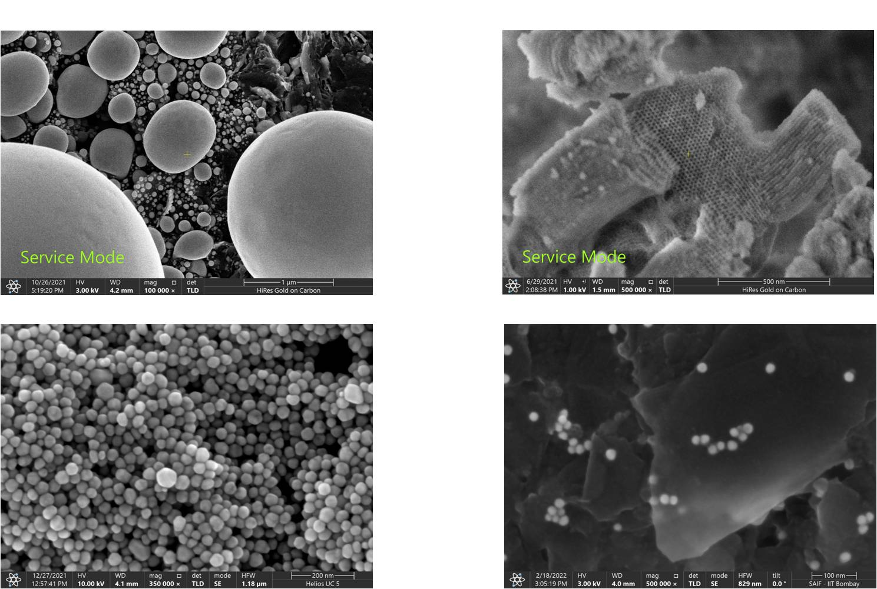
IMAGE ANALYSIS on the Dual beam-FIB at SAIF
Tin balls on Carbon
Mesoporous Silica
Au on Ag Nano Forest
Au on Carbon

