Slide 1
Environmental Scanning Electron Microscope (ESEM)

Slide 3
Environmental Scanning Electron Microscope
Imaging Voltage: 10Kv- 30kV
Modes:
High Vacuum Mode
Low Vacuum Mode
Environmental Mode (ESEM mode)

Slide 4
High Vacuum Mode
Detector: Everhart Thornley Detector (ETD)
Vacuum range - below 4.5e-4 Pa
Sample :
Conducting
Non conducting sample can be coated and observed

Slide 5
Fractrography and cutting tools Fractography of corroded CT Four fluted micro end mill

Slide 6
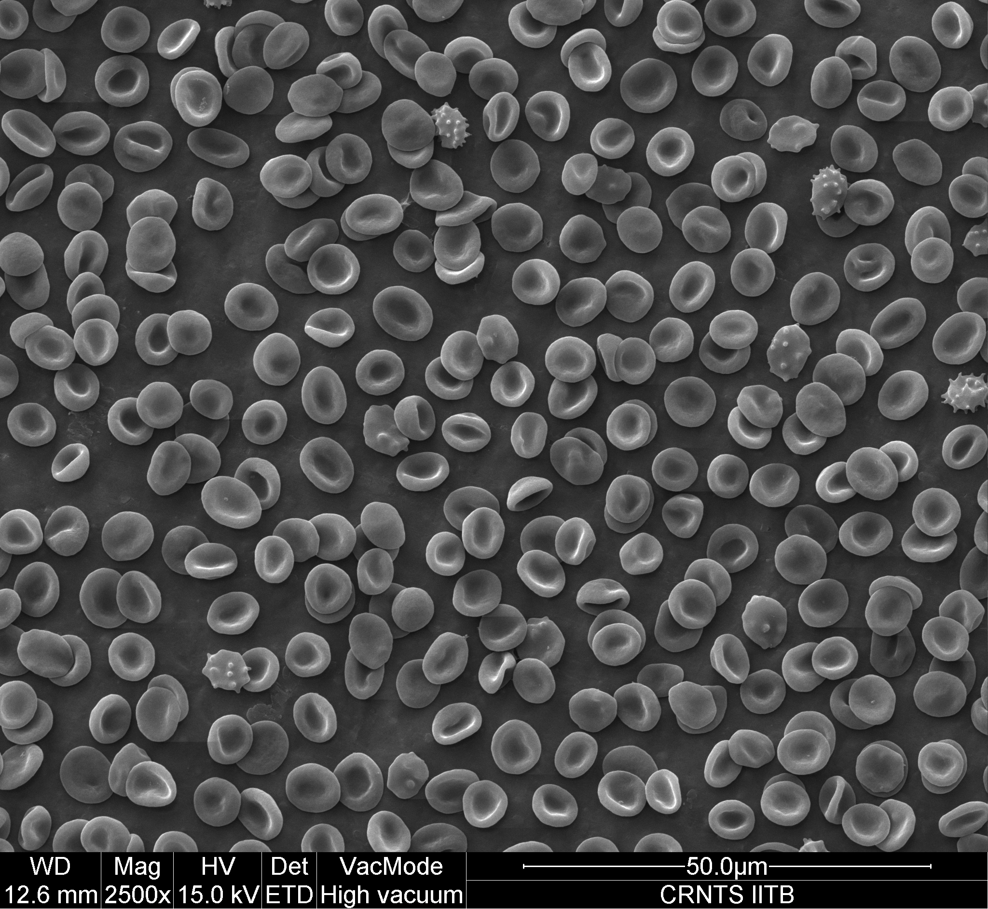
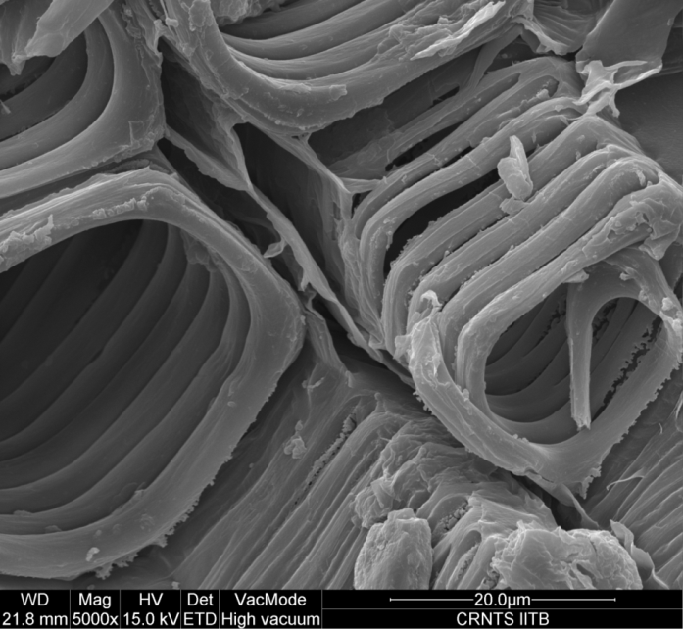
Biological Samples Red Blood cells Plant leaf structure
Sample are non-conducting and coated

Slide 7
Scaffold Fossil
Sample are non-conducting and coated

Slide 8
Low Vacuum Mode
Detector: Large Field Detector (LFD)
Pressure range: 10-130 Pa
Sample :
Non- Conducting
Un-coated

Slide 9
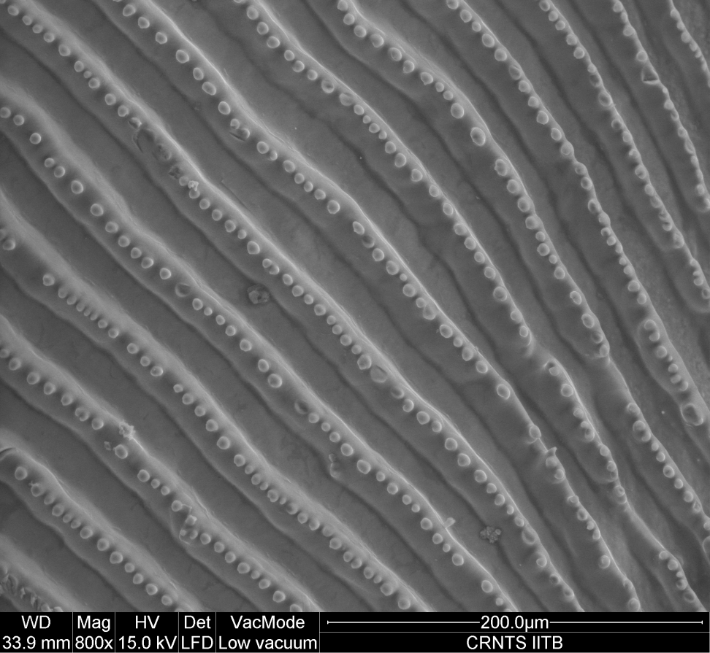
Flower Fish scales
Low vacuum mode
Sample are non-conducting and un coated

Slide 10
ESEM Mode
Detector: Gaseous Secondary Electron Detector (GSED)
Pressure range 130 – 4000 pa
Peltier stage
Sample :
Wet and Moist samples

Slide 11
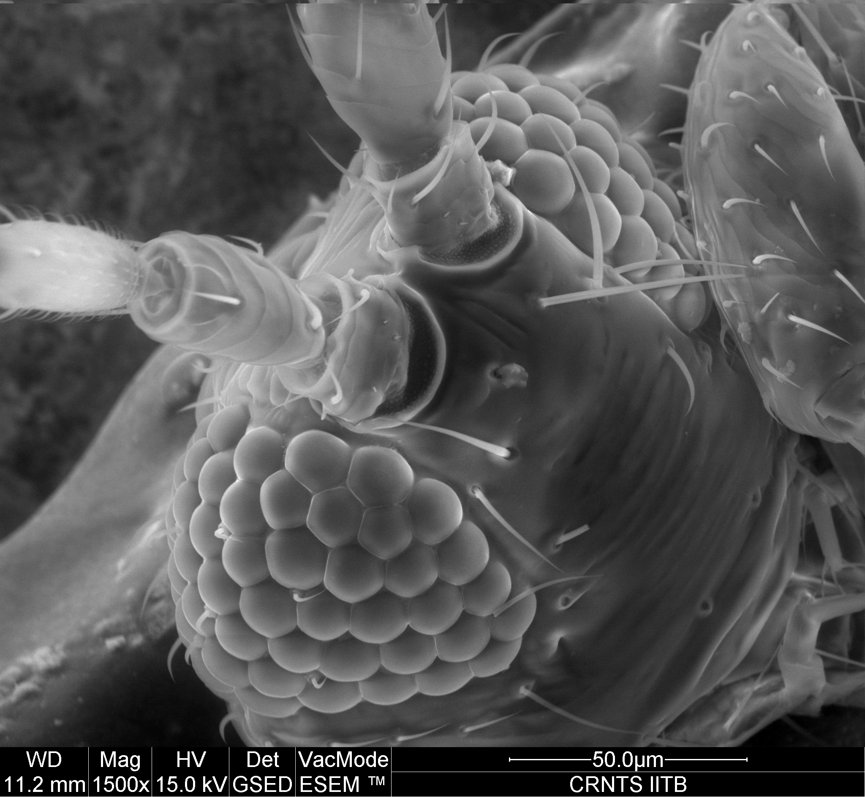
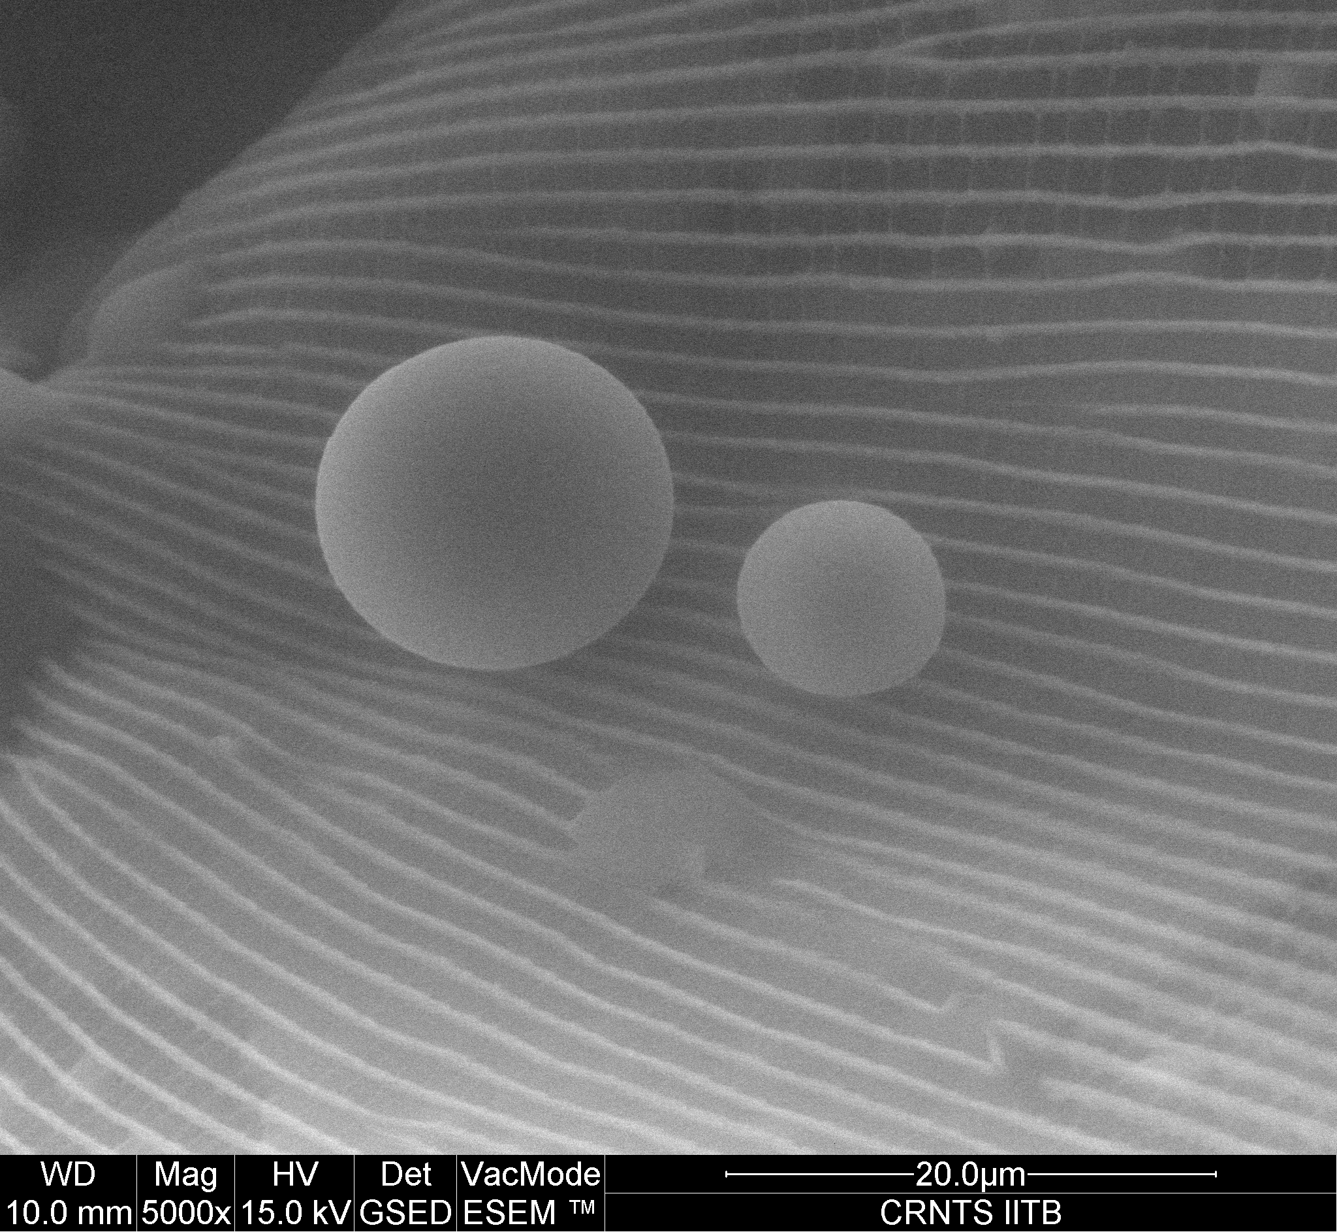
Ant Water droplets on butterfly wing
ESEM
Sample are non-conducting and coated

Slide 12
Back Scattered Imaging
Detector: Solid State Detector (SSD)
Used in High Vacuum and Low Vacuum Mode
Topological and Compositional contrast can be observed
Sample :
Conducting
Non- Conducting

Slide 13
Back Scattered Imaging
Rock-pyrites
AlZr fibers

Slide 14
Energy Dispersive X-ray Spectroscopy (EDS)
Chemical characterization of sample.
Each element has a unique atomic structure allowing unique set of peaks on X ray spectrum
The number and energy of X ray emitted is measured by EDS.

Slide 15
EDS analysis

Slide 16
Selected area EDS with Quantification

Slide 17
Mapping and line analysis
X-ray mapping provides images of elemental distribution in a sample.
Different phases in a material can studied
X- ray maps are produced by recording number of X ray photons of a specified energy generated from each point over a fixed counting time while the electron beam is rastered over a rectangular area.

Slide 18
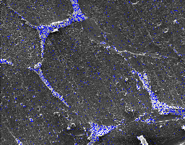
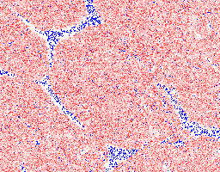
Mapping Sample: Al-Sn alloys

Slide 19
Line analysis
Chromium carbide - Nickel chromium coating on Mild steel substrate

Slide 20
Thank you.

