Slide 1
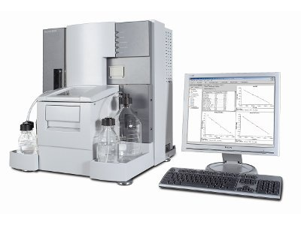

Surface Plasmon Resonance(SPR) : Basics to Application
Convener: Prof. Samir Maji
Facility TA: Rucha Gadre
SPR Central facility, IIT Bombay
IIT Bombay SPR Central facility

Slide 2
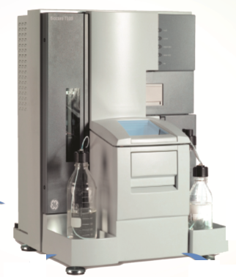
overview
Introduction to SPR
Assay Development
Applications

Slide 3
Introduction to SPR
Optical technique to detect Bimolecular Interactions
Label-free (no tags) detection of binding events
Real-time assay (not end-point)
Direct measurement
Study protein-protein, protein-nucleic acids, protein-small molecules, Antibody-protein, protein-lipids, Protein-Peptide, protein-drug, etc
Life processes are critically dependent on the formation of bimolecular complexes their communications, networking.
Several molecular interactions are taking place in a biological system such as protein-protein, protein-DNA/RNA, protein-small molecules, enzyme-substrate etc, which govern all sort of cellular processes like signal transduction, gene expression, and metabolic pathways.
Hence studying bimolecular interactions are central to understanding how biological systems functions and their binding events or Kinetic studies reveal how these activities are regulated.
This information eventually advancing our understanding of drug development, elucidates disease mechanisms, and drives biotechnological innovations. By delving into these molecular interactions, we can uncover the intricacies of life at a fundamental level, leading to significant scientific and medical breakthroughs.

Slide 4
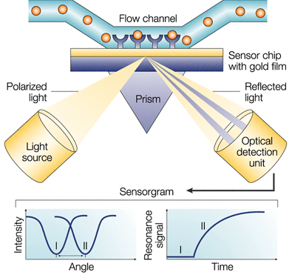
SPR Overview
Principle:
Sensor Chip
Interacting Partners
A light source
Detector

Slide 5
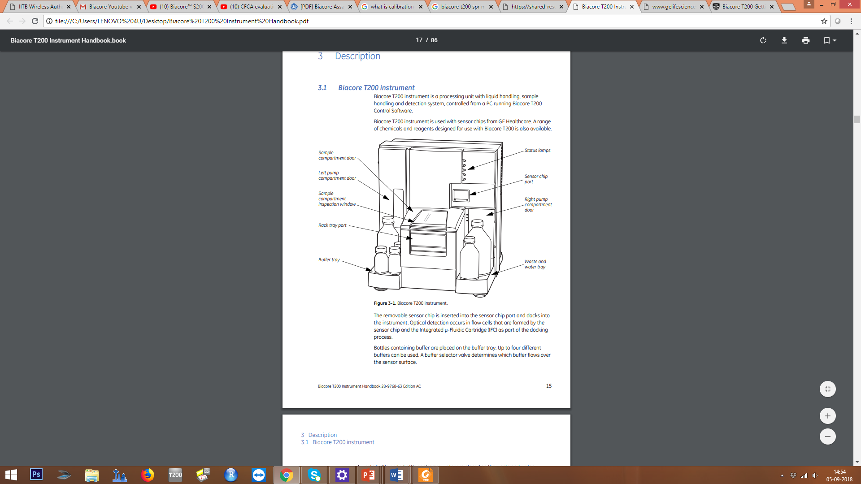
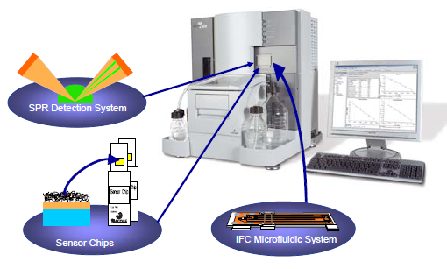
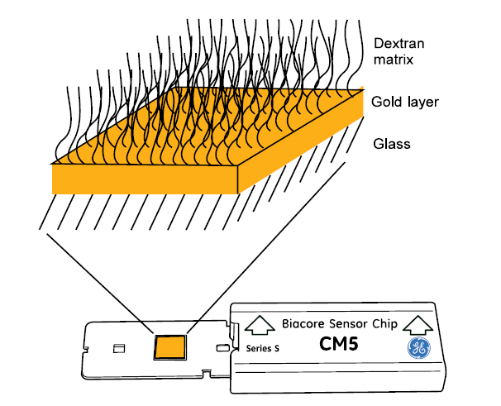
Biacore T200 and accessories
The interaction being studied takes place on the gold-covered side of the sensor chip, opposite from the side where the light is reflected.
Sample containing analyte is supplied in a controlled fashion to the sensor surface through an IFC (Integrated Microfluidic Cartridge) system.

Slide 6
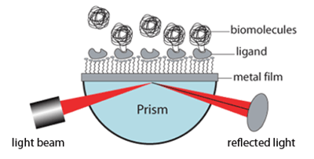
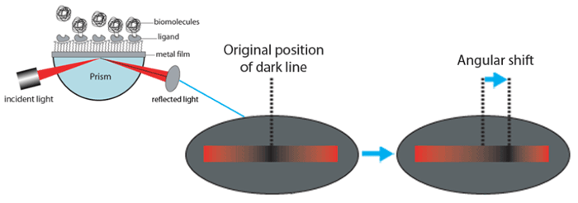
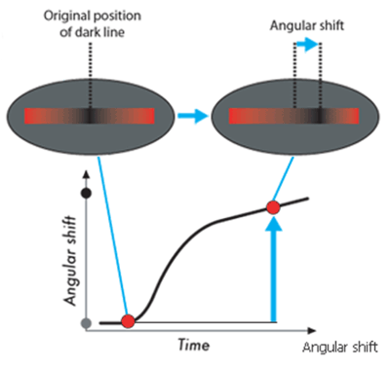
How does Surface Plasmon Resonance works??
1. A light is incident upon a metal film through a prism and the reflected beam is collected and analyzed.
1
2.The excitation of surface plasmons results in a dark line in the reflected beam, and the angular position of the dark line shifts as a molecule binding event takes place.
2
3.The angular shift vs. time provides a good study of binding kinetics.
The reverse process, molecular dissociation, can be studied in a similar way.
3

Slide 7
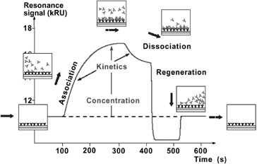
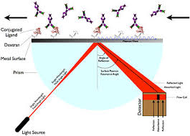
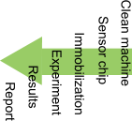
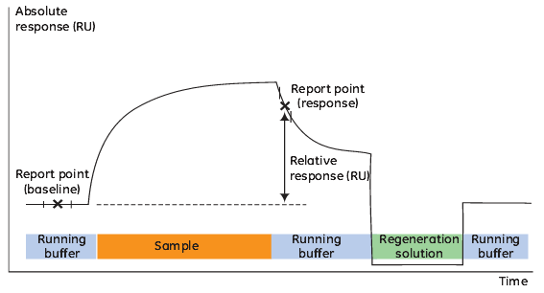
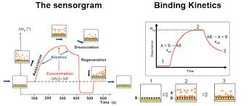
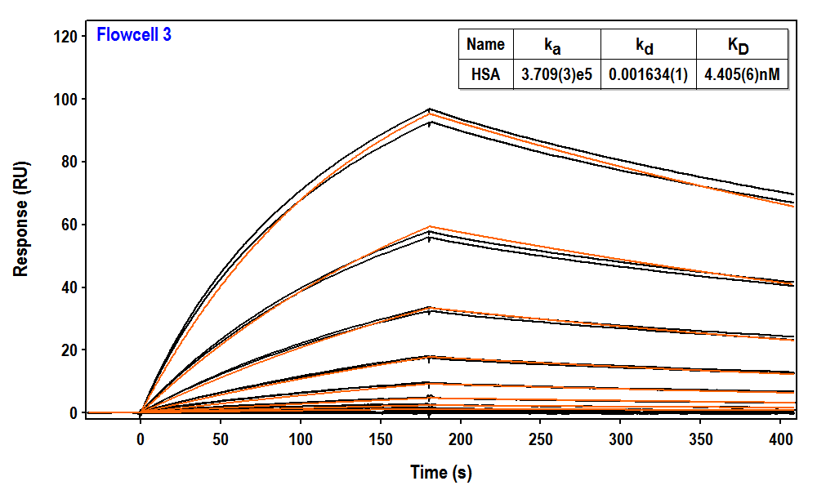
Tool For Characterizing And Quantifying Various Biomolecular interactions
Work Flow
Binding event
Results

Slide 8

Assay Development: Steps of Biacore Assay Development
3 major Steps in an SPR assay
Immobilization
Attachment of ligand (SPR term) to sensor chip surface
Sample Injection/Interaction
Analyte in running buffer flows over ligand immobilized on sensor and binds to it
Output = Sensorgram
Regeneration
Removal of bound analyte from the ligand
Ready for next round of Analyte Binding
Surface preparation
Sample injection
Regeneration Evaluation

Slide 9
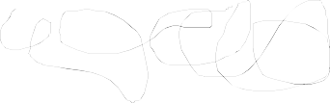
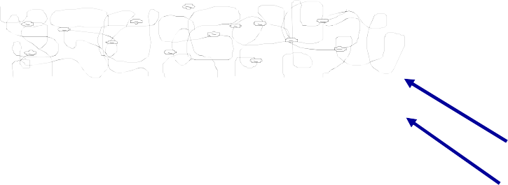

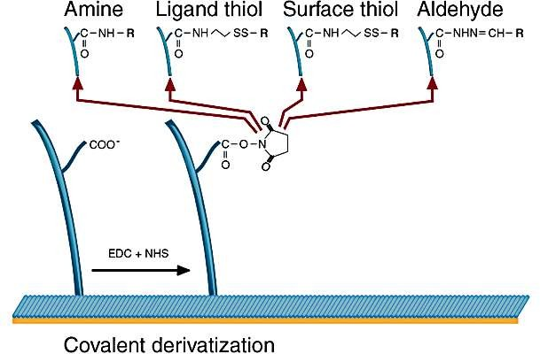
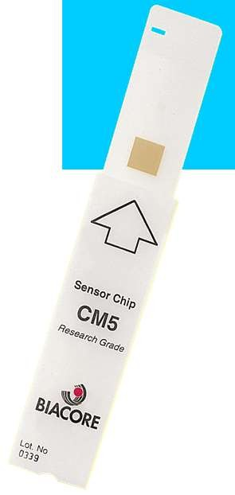
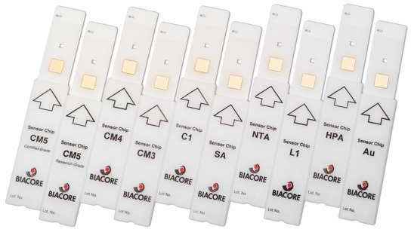



Immobilization: Surface preparation
Attachment of ligand (SPR term) to sensor chip surface
Direct (Covalent immobilization)
ligand is linked to the surface through a covalent chemical bond.
e.g., Amine, Aldehyde, Thiol, etc.
Indirect (Capture Method for Immobilization)
Capture molecule (e.g., streptavidin) immobilized on the surface using covalent chemistry
Interaction with a capturing molecule to bind the ligand to the sensor surface
Dextran CM5
☑ hydrophilic
☑ for coupling
Linker layer Gold 50 nm
☑ for SPR
Glass support
☑ Stability
The Dextran Matrix
Where to immobilize
Hydrophilic
Flexible
Resembles a 2% aqueous dextran solution environment
Low non-specific binding
High binding capacity
Easy to activate and use for covalent coupling
Withstands extensive regeneration
The Gold Layer: Metal Plasmon and Inert nature

Slide 10
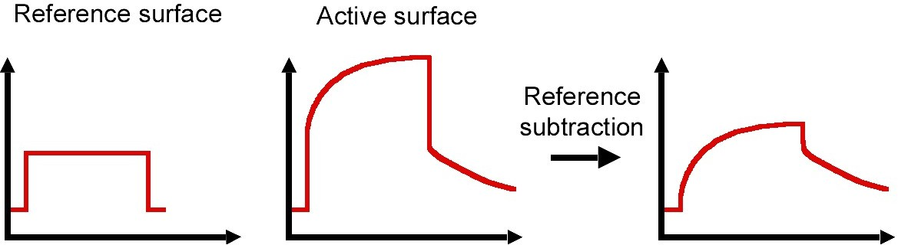
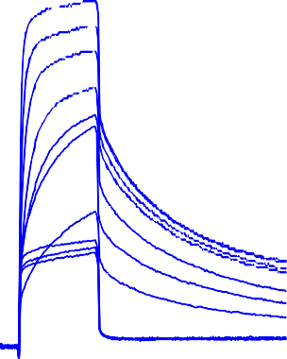
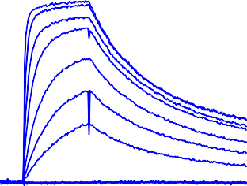
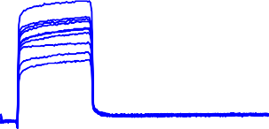
Sample Injection
Response
RU 160
140
120
100
80
60
40
20
0
-20
Active surface
Reference surface
Corrected data
500 s
We used 2 flow channels in one experiment-ref and the test.
Immobilization is at test reference
Analyte is flown from both FC.
The data is obtained by test fc-ref fc
Also only buffer is also passed as an sample, which is also subtracted. This is called as double referencing.
Reference subtraction is important for kinetic and .

Slide 11
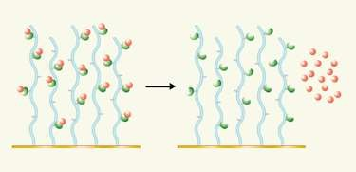
Regeneration
Response
Remove bound analyte completely from the surface
The activity of the surface must remain unaffected
Efficient regeneration is crucial for high-quality data
good
bad
Cycle 1
Cycle 2
Time
Selection of regeneration
» Contact time and flow
» Harshness
Impact on ligand activity
» Reproducibility
» Baseline Stability

Slide 12
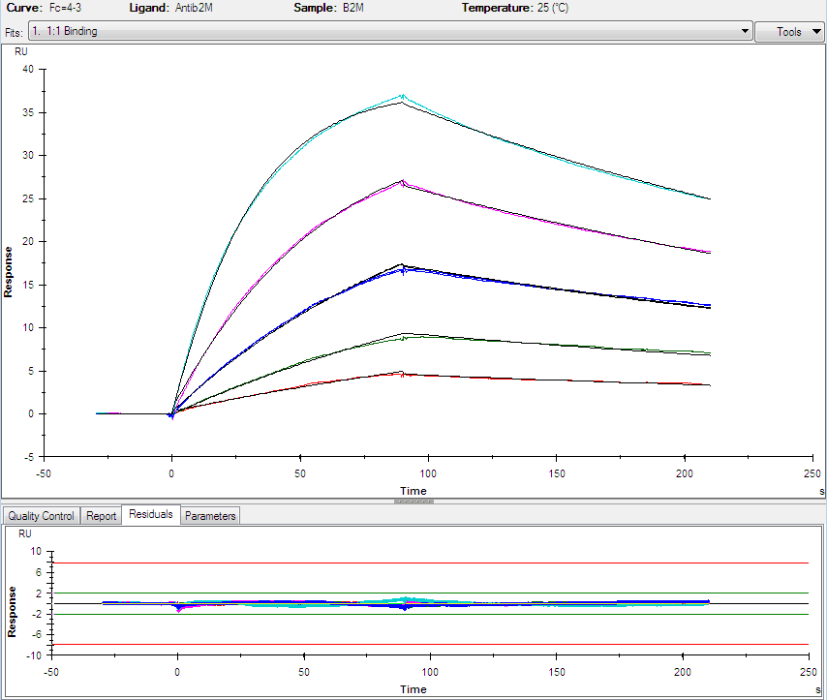
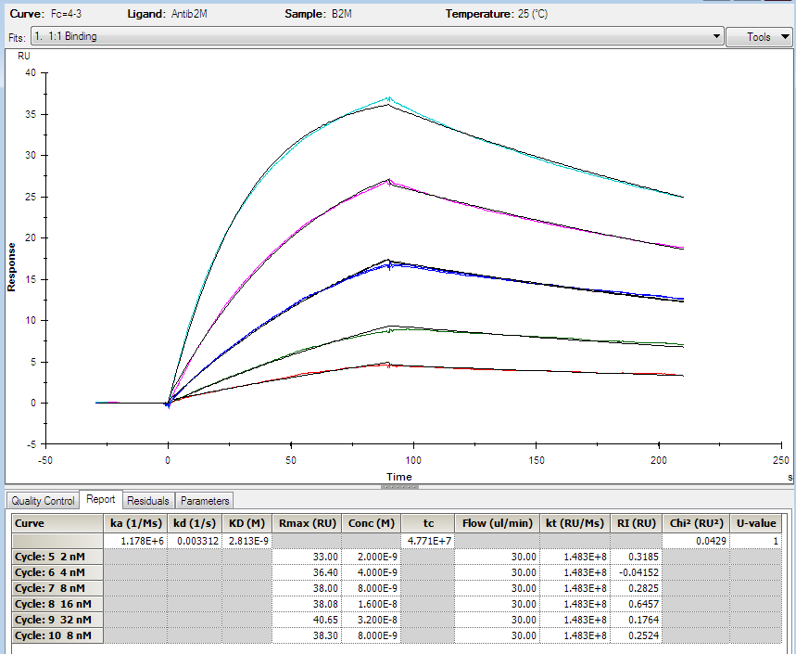
Result: Kinetics Assay

Slide 13
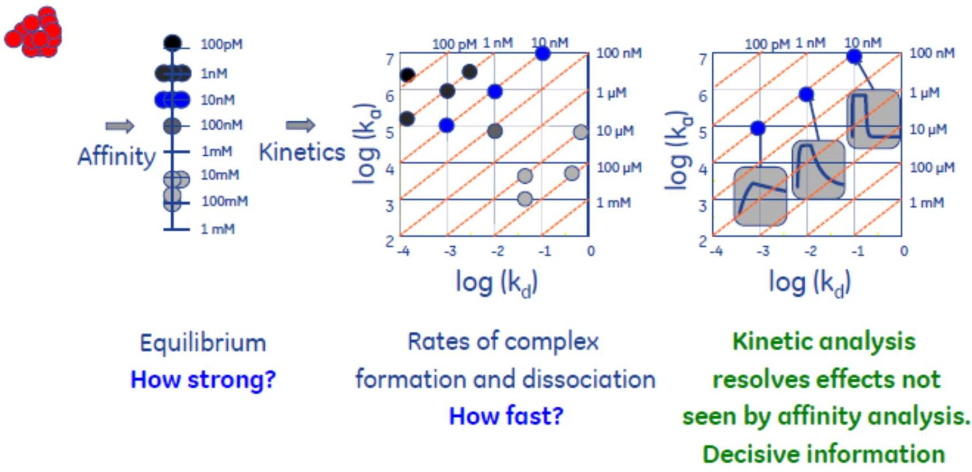
SPR Applications
Types of Assays
  Binding (Yes/No)
  Specificity
  Kinetics (Strength of Binding; ka, kd and KD)
  Concentration
Wide Range of Biomolecular Interactions
  Proteins
  Nucleic Acids
  Lipids and Membrane-Associated molecules
  Carbohydrates
  LMW compounds (< 200 Da)
  Whole Cells
  Viruses/Bacteria
Example :Drug Discovery

Slide 14
Conclusions
It measures Refractive index changes at sensor surface
Label-free, Direct, Real time measurement of bimolecular interaction
Direct Method vs Capture Method of Immobilization
3 Major steps:
Immobilization, Sample Injection/Interaction, Regeneration
Double Referencing important
Applications: Binding, Kinetics, Concentration, etc
Sensorgram shape determines kinetics of binding- KD=Kd/Ka

Slide 15



