Slide 1
MATRIX ASSISTED LASER DESORPTION/ IONIZATION TIME - OF –FLIGHT Principle & Applications

Slide 2
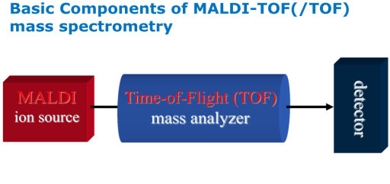
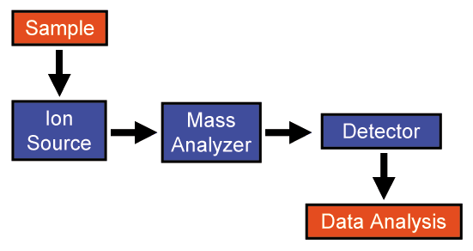
MALDI
Mass Spectrometers
Ionization
Ion Separation
Ion Detection
Ion Source
Electron ionization
Chemical ionization
Electrospray ionization
MALDI
Mass Analyzer
Quadruple
Magnetic sector filed
Ion trap
Time of flight
Detector
Electron multiplier
Multichannel plate
Faraday cup

Slide 3
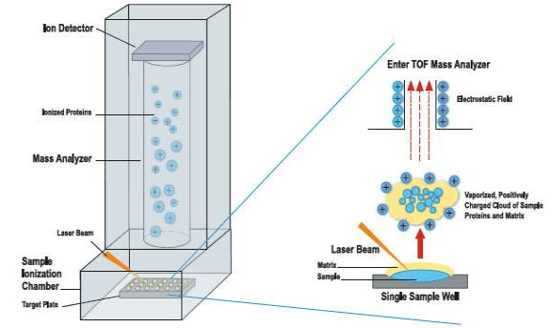
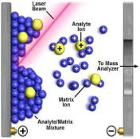
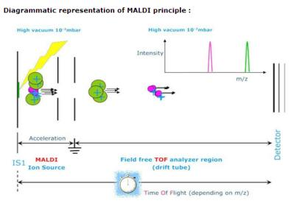
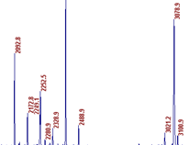
PRINCIPLE
10⁴
3.0
2.0
Relative Intensity (a.u.)
1.0
0.5
0
20,000
22,000
24,000
26,000
28,000
30,000
m/z

Slide 4
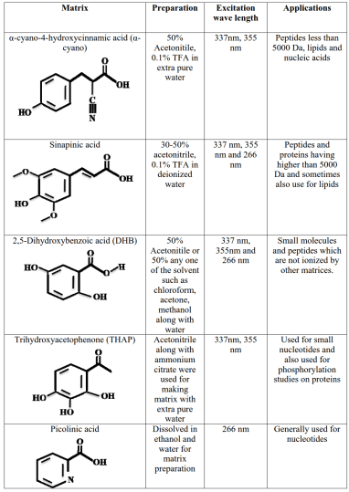
COMMONLY USED MATRIXES IN MALDI

Slide 5
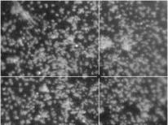
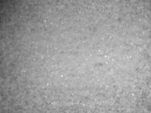
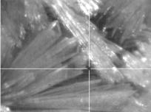
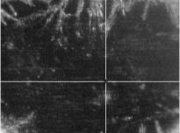
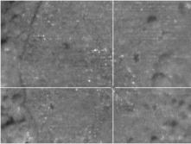
SCREENSHOTS OF COMMON MATRIXES USED IN MALDI
HCCA matrix
Sinapinic acid matrix
DHB matrix
3-HPA matrix
Terthiophene matrix
Dithranol matrix

Slide 6
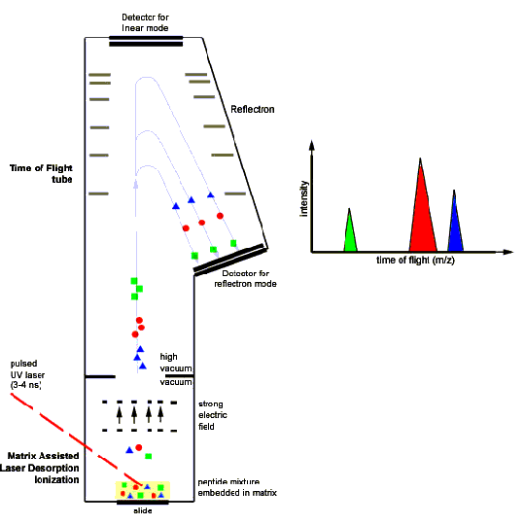
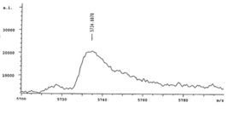
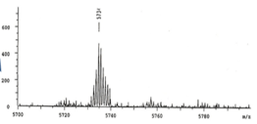
LINEAR Vs REFLECTRON MODES
Linear mode
Linear mode
Reflectron mode
Reflectron mode

Slide 7
MALDI TOF - ANIMATION

Slide 8
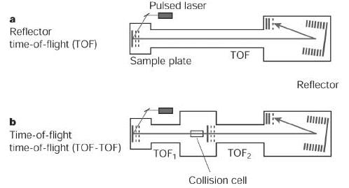
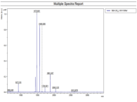
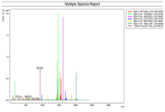
MALDI MS/MS or TOF/TOF
Precursor Ion Fragmentation

Slide 9
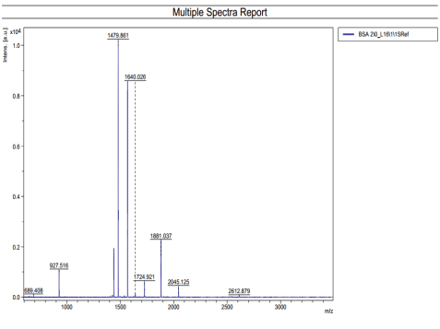
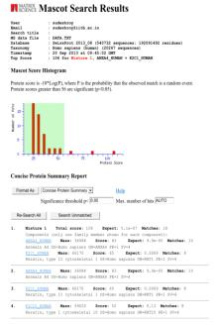
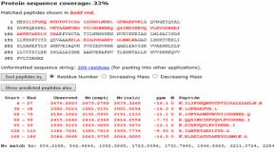
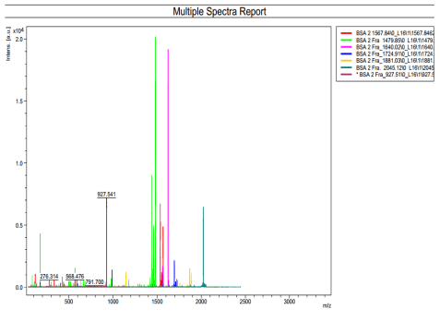
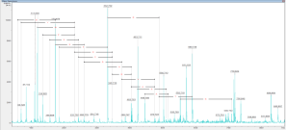
MS/MS – PROTEIN IDENTIFICATION
MS SPECTRA
LGFNAEPVR
MS/MS SPECTRA
Mascot search results & Interpretation

Slide 10
Representative Spectras of Different Sample Types

Slide 11
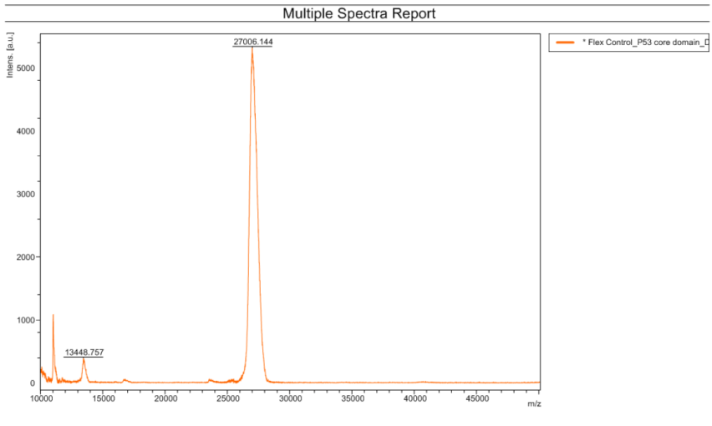
Protein Spectra- Mass Identification
P53 protein

Slide 12
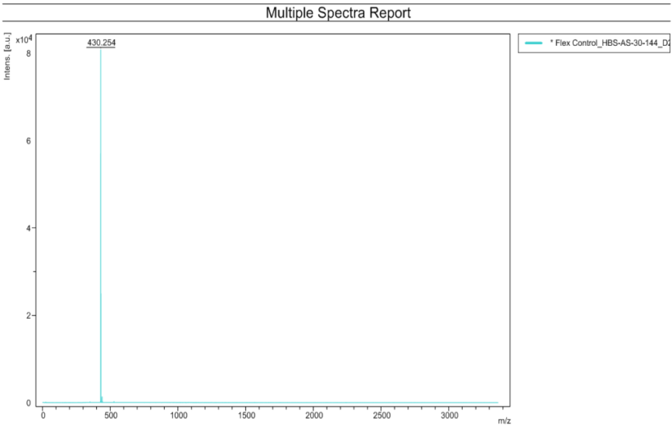
Peptide Spectra- Mass Identification
Synthetic peptide

Slide 13
Peptide Spectra- MS
BSA

Slide 14
Peptide Spectra- MS/MS
BSA

Slide 15
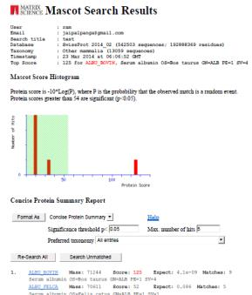
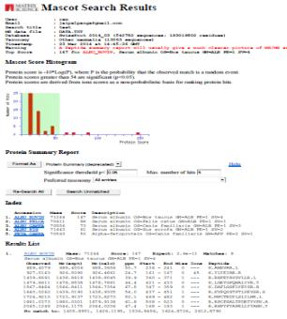
Peptide Mass Fingerprint Using MALDI
Conclusion- Expected mass was observed in MS spectra
Conclusion- Expected protein gives first hit in MS/MS spectra

Slide 16
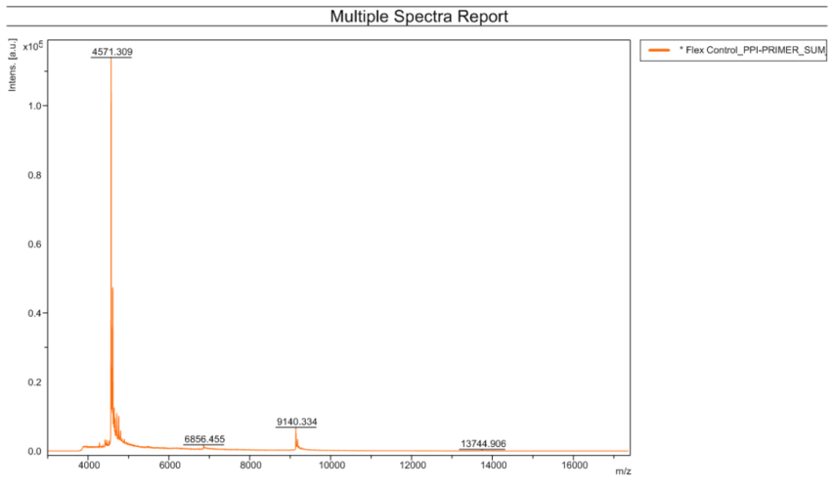
Nucleic acid Spectra- Mass Identification
Synthesized Single stranded DNA

Slide 17
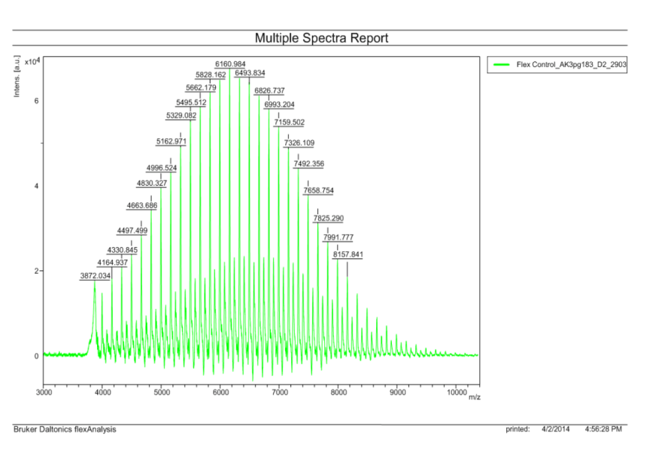
Polymer Spectra- Polymer characterization
P3HT polymer sample

Slide 18
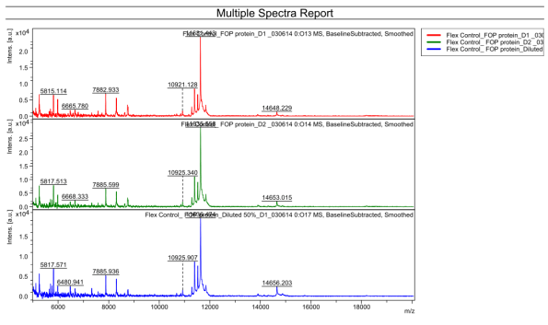
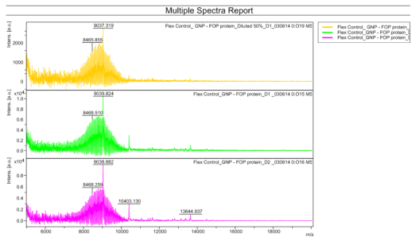
Protein binding
Gold Nano particle binding to Fish Oil protein

Slide 19
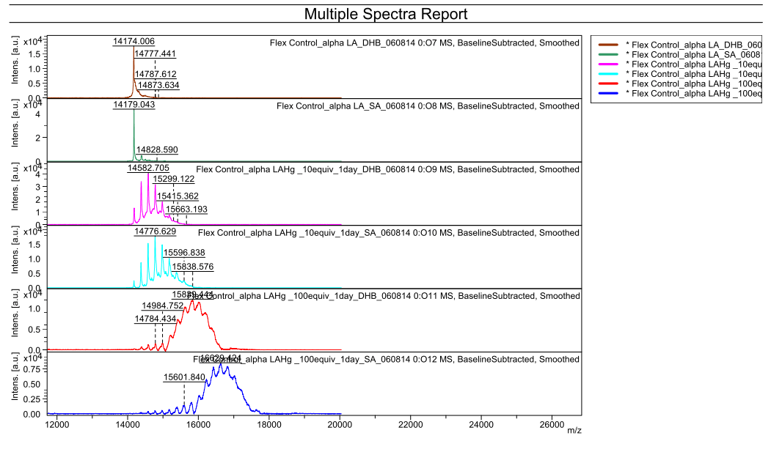
Protein binding
Mercury binding to Lactalbumin

Slide 20
Thank you

